Slide 1
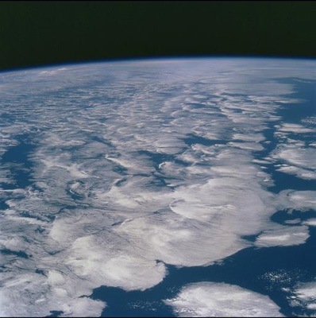


Recent research updates for SMURPHS
Richard Allan
SMURPHS project meeting, Reading, 24 April 2018

Slide 2
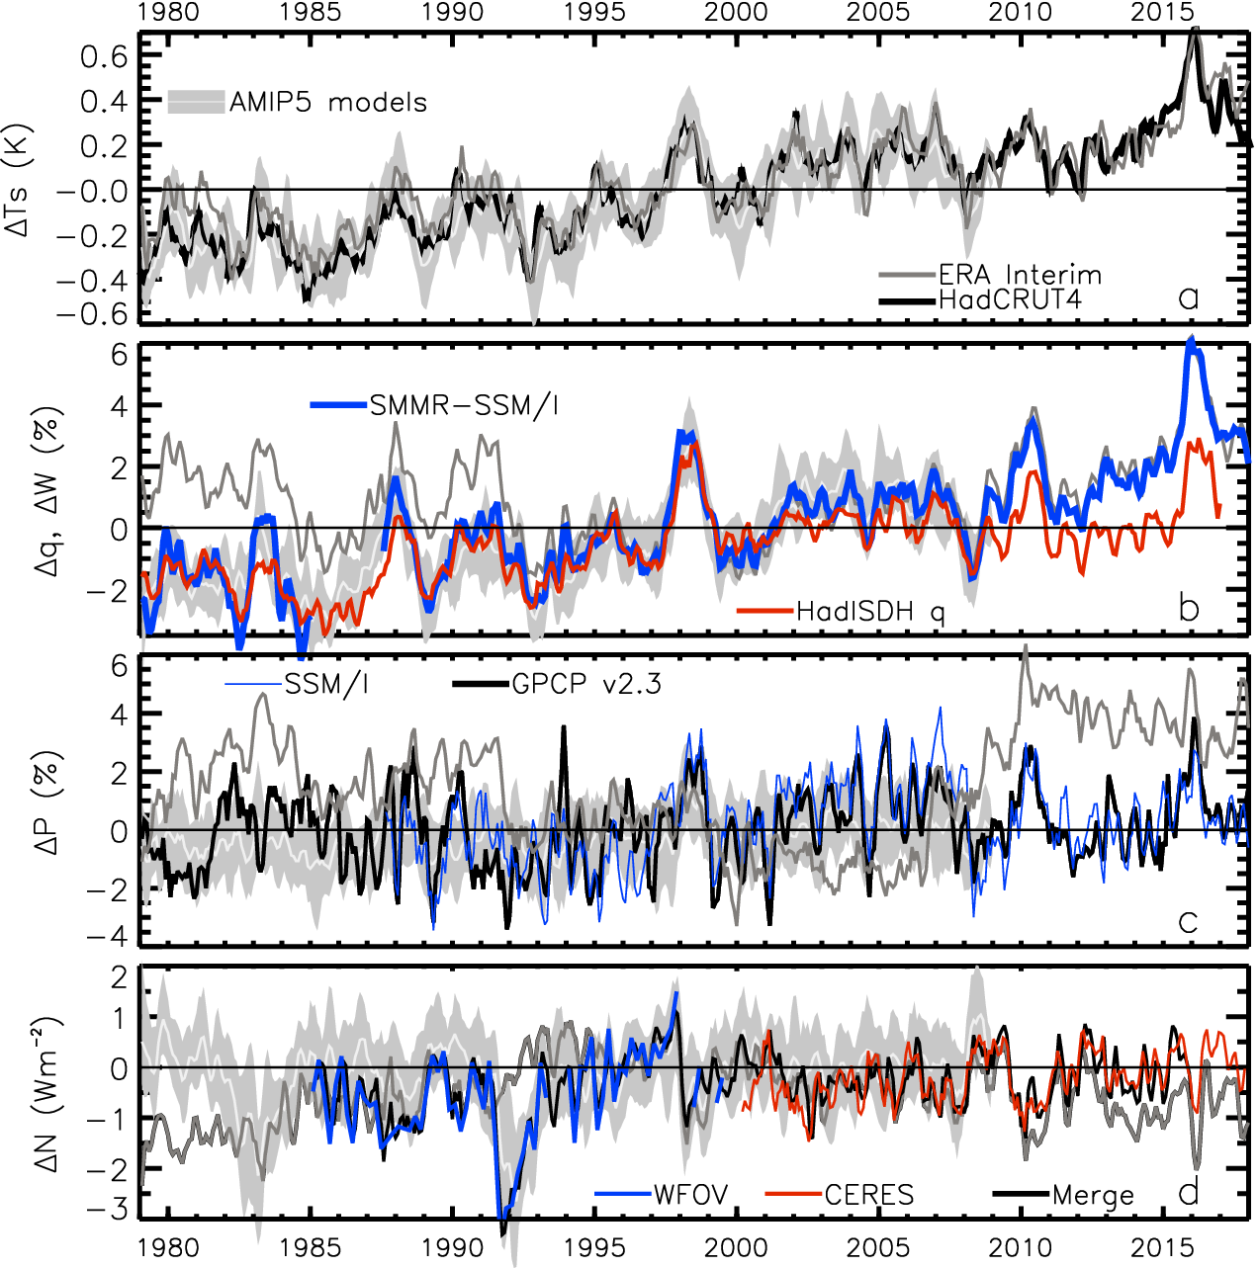
TEMPERATURE anomaly (degC)
WATER VAPOUR anomaly (%)
PRECIPITATION anomaly (%)
2.8
1.8
0.8
-0.2
-1.2
-2.2
ENERGY BUDGET anomaly (Wm⁻²)
Energy imbalance (Wm⁻²)

Slide 3
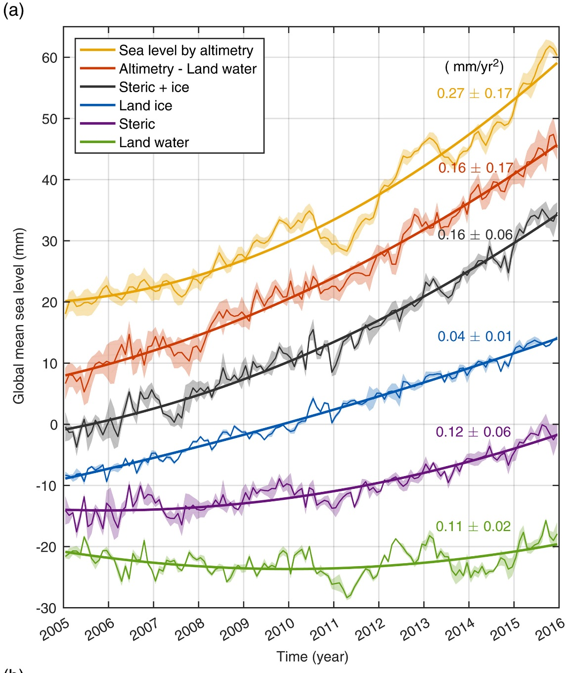
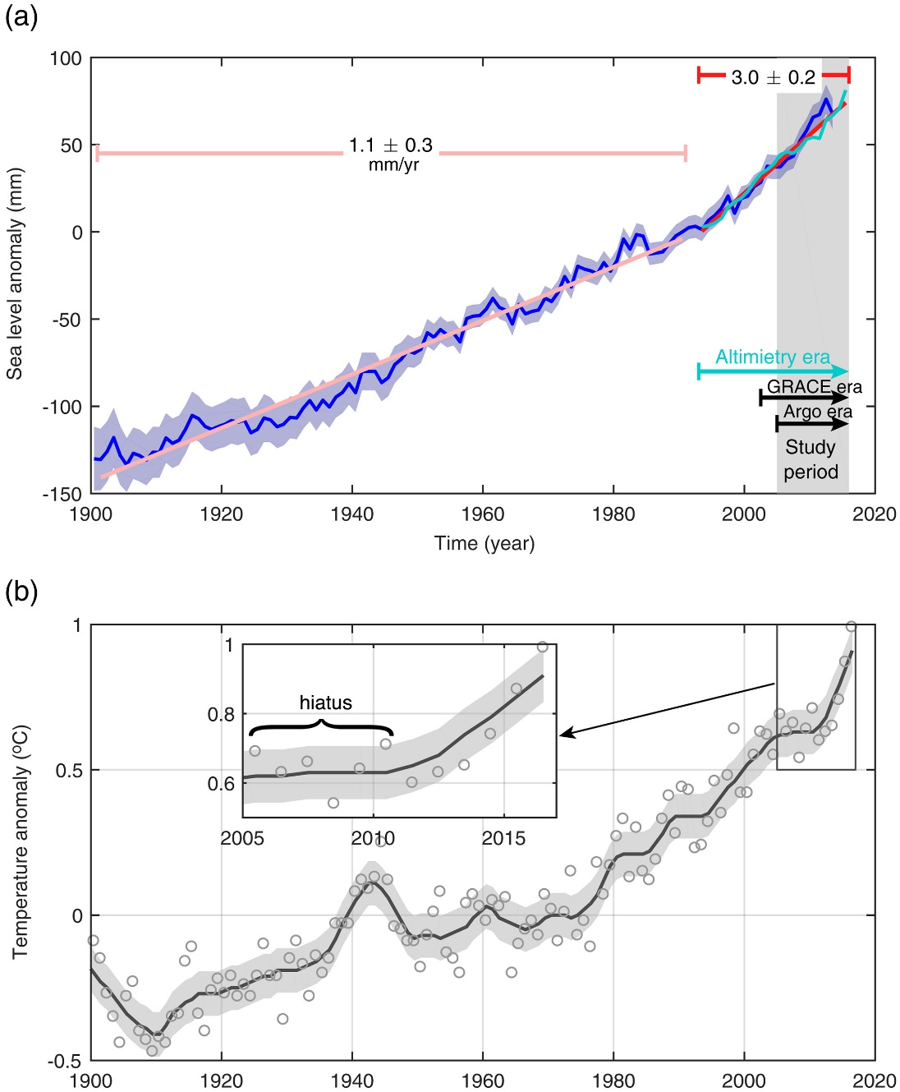
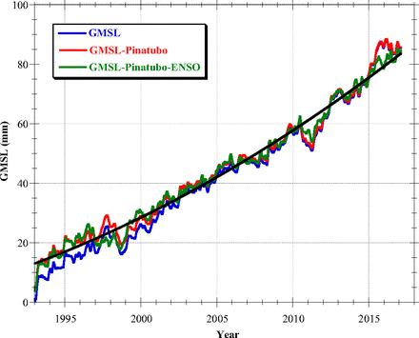
Recent research: Sea level rise acceleration
Nerem et al. (2018) PNAS: sea level rise accelerating by 0.84 mm/yr per decade in agreement with energy budget estimates
Yi et al. (2017) GRL: accelerated 0.27 mm/yr each year during 2005-2015 (?), 44% due to thermal expansion, 41% to land water storage & 15% ice melt
Yi et al. (2017) GRL

Slide 4
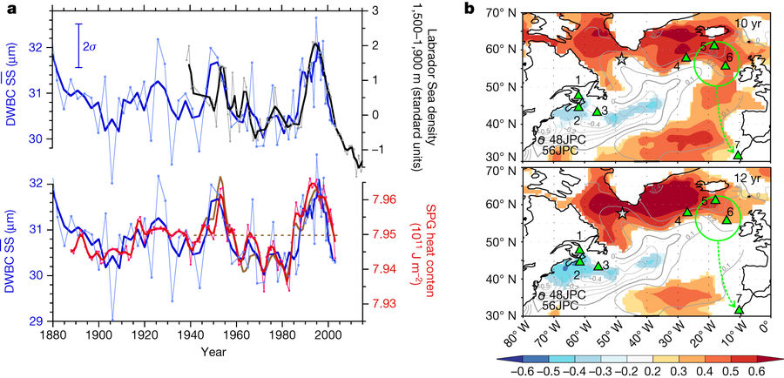
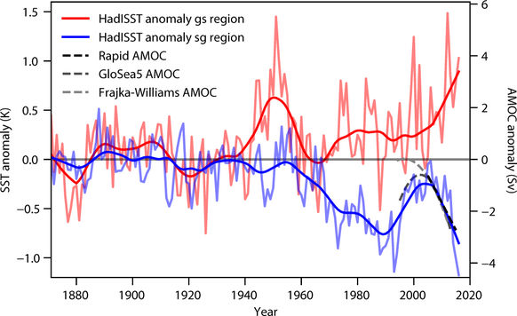
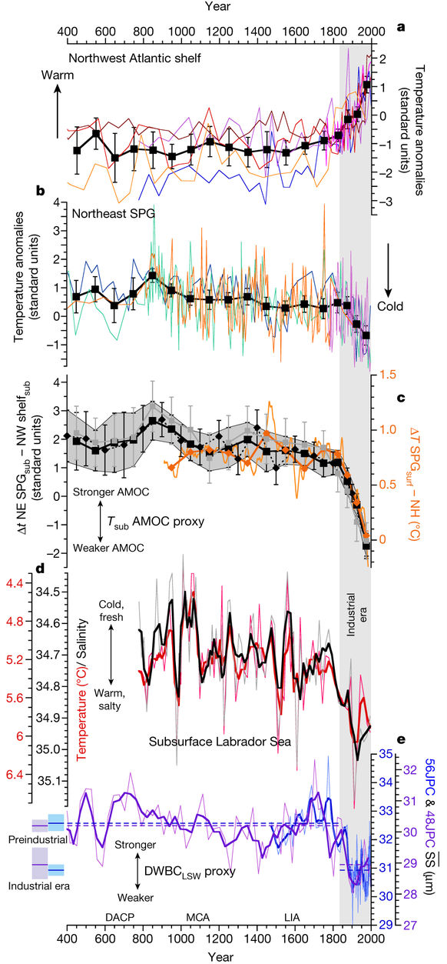
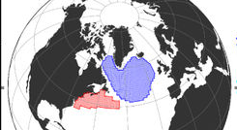
Updates: AMOC changes in context
AMOC in weak state unprecedented in past 1600 years (Thornalley et al. 2018; Caesar et al. 2018, Nature)
10yr SPG heat content lag →
Caesar et al. 2018
Thornalley et al. 2018
*
Is recent strengthening (*~1995-2005) temporary flip back to “normal” state?

Slide 5
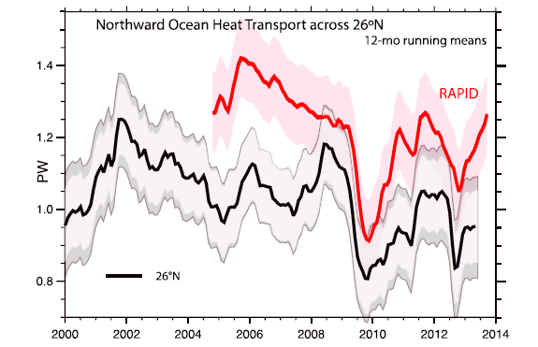
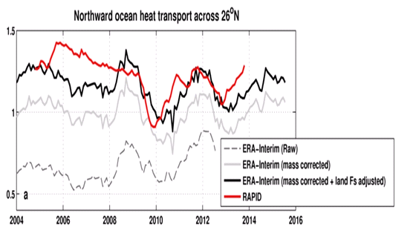
Inferred ocean heat transport@26ºN
Trenberth & Fasullo (2017) GRL
Compare indirect method with RAPID observations
Is TF2017 discrepancy due to lack of land F_{s} adjustment?
Ocean heating from ORAS4 (0-700m).
Better agreement after land Fs adjustment
2004-2013
RAPID 1.23 PW
TF2017 1.00 PW
Liu et al: 1.16 PW
large uncertainty

Slide 6
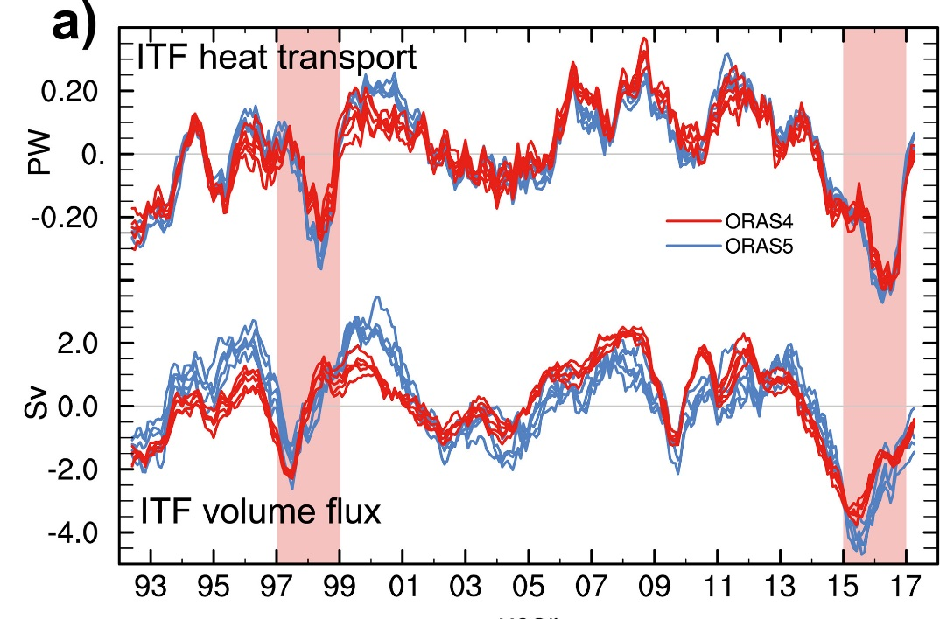

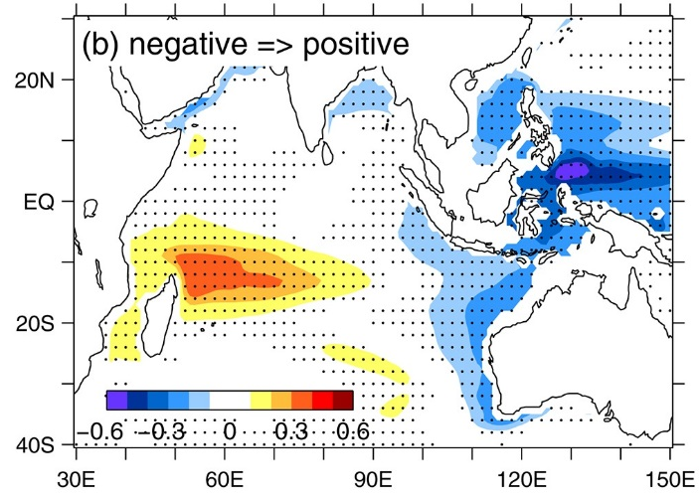
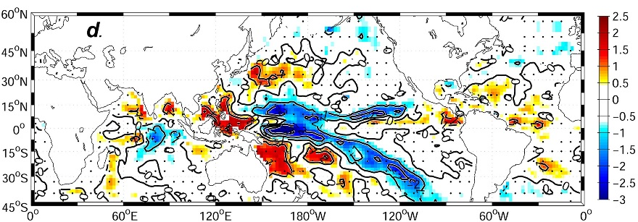
Updates: Indonesian Through Flow
← Mayer et al. (2018) GRL: Unprecedented reduction of the ITF Heat Transport & unusual radiation anomalies in 2015-17 El Nino
Li et al. (2017) GRL: SE Indian Ocean hotspot early 2000s from increased ITF & local atmospheric forcing
Hu & Sprintall (2017) GRL: explained by increased precipitation & freshening

Slide 7
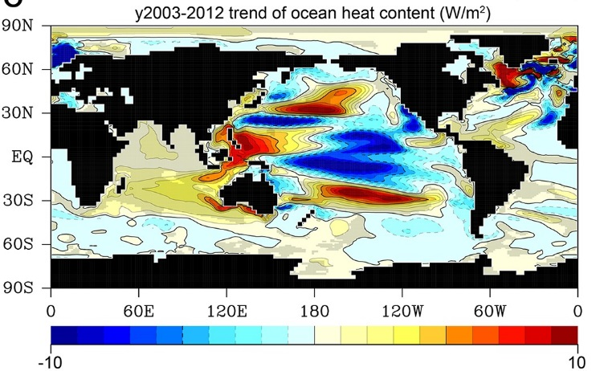
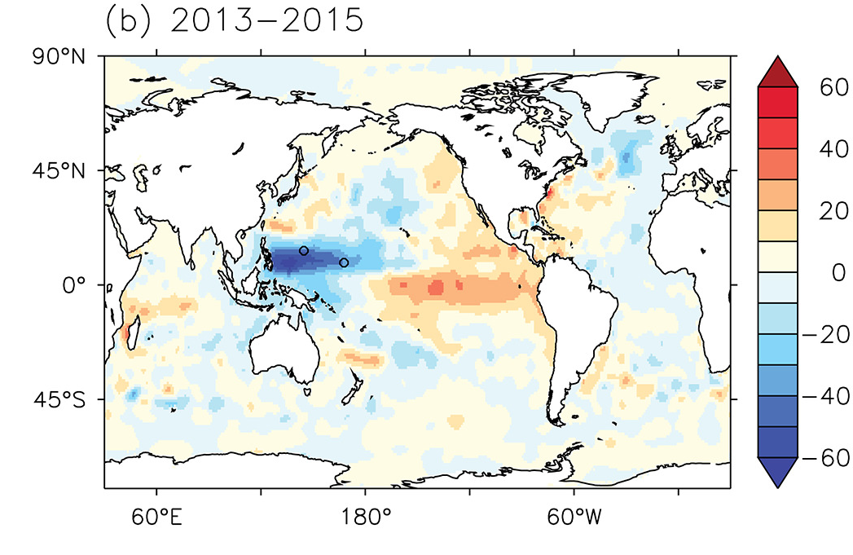
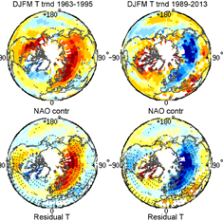
Spatiotemporal evolution
Oka & Watanabe (2017) GRL: subsurface warming in equatorial Pacific (1998-2002) then increasing heat storage below 700m after 2002 from Ekman transport from tropics to southern subtropics (top) →
Yin et al. (2018) GRL: record 0.24ºC rise in global temperature 2014-2016 due to ocean heat release from north western tropical Pacific (middle) →
Iles et al. (2017) ERL: NAO trends quartered NH winter warming in 1989-2013 period, contributing to slowdown in global surface warming (bottom) →
  (see also Deser et al. (2017) GRL)
Modelling evidence: rates of global surface warming not exclusively linked to east Pacific SST (Yao et al. (2017) Nature Climate; Känel et al. (2017) GRL) but imposing observed changes in shortwave cloud radiative effect in E. Pacific appears to explain much of SST/circulation variability of last 16 years (Burgman et al. (2017) GRL)

Slide 8
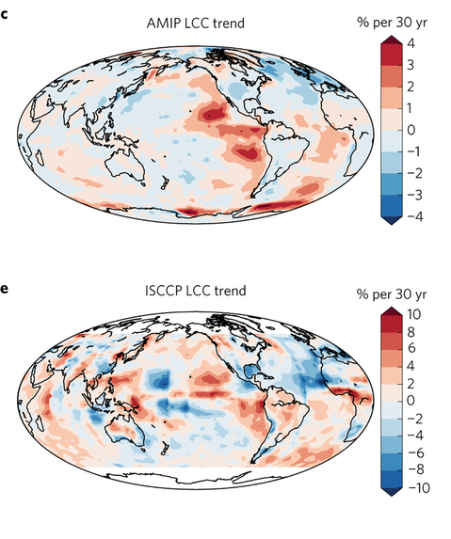
Feedbacks on internal and forced climate change involving regional energy budget
Low Cloud Cover trend 1980s-2000s
Distinct feedbacks on internal variability & forced change e.g. Brown et al. 2016 J. Clim; Xie et al. 2015 Nature Geosci; England et al. (2014) Nature Clim
Spatial patterns of warming crucial for feedbacks & climate sensitivity e.g. He & Soden (2016) J. Clim; Richardson et al. (2016) Nature Clim Change; Gregory & Andrews (2016) GRL
Is there an ocean dynamics thermostat (Clement et al. 1996 J. Clim)
OBSERVATIONS AMIP MODELS
Zhou et al. (2016) Nature Geosci
Notes:
Combining decadal observations of cloud, radiation and energy transports is leading to advances in understanding regional to global feedbacks
There is emerging evidence of contrasting energy budget responses/feedbacks acting on internal and forced variability
The spatial pattern of warming is crucial in determining global feedback responses; accounting for this may help in determining climate sensitivity from observations

Slide 9
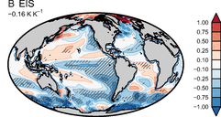
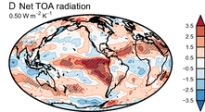
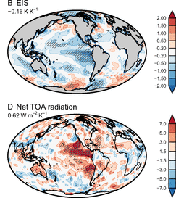
Feedbacks/Climate sensitivity
Late minus early regression
Increased climate sensitivity over time linked to cloud & lapse rate feedbacks relating to SST pattern evolution & changes in atmospheric stability (Ceppi and Gregory (2017) PNAS; Andrews and Webb (2017) J. Clim)
Marvel et al. (2018) GRL: climate sensitivity diagnosed from present-day SST-forced experiments poor proxy for future due to poor constraint of stratocumulus cloud responses
Silvers et al. (2017) GRL: variability of the climate feedback parameter not driven by stratocumulus dominated regions in the eastern ocean basins, but rather by the cloudy response in the rest of the tropics.
OBS variability (scaled)

Slide 10
Radiative forcing
Monerie et al. (2017) ERL: Volcanic forcing explains suppressed surface warming trend 2003-2012 (0.08ºC/decade), cooling 0.04ºC/decade during 2008-2012, more noticeable in NH but not affecting continued increases in global heat content.
Checa-Garcia et al. (2018) GRL: larger CMIP6 ozone forcing & recent renewed growth
Dong & McPhaden (2017) ERL: radiative forcing dominates decadal temperature trends apart from during extreme phases of internal variability
More stuff: http://www.met.reading.ac.uk/~sgs02rpa/research/DEEP-C.html#PAPERS
What single paper could we combine expertise to focus on?
  Tools (models, observations, methods) we can combine
  What science question(s) can we tackle?

Slide 11
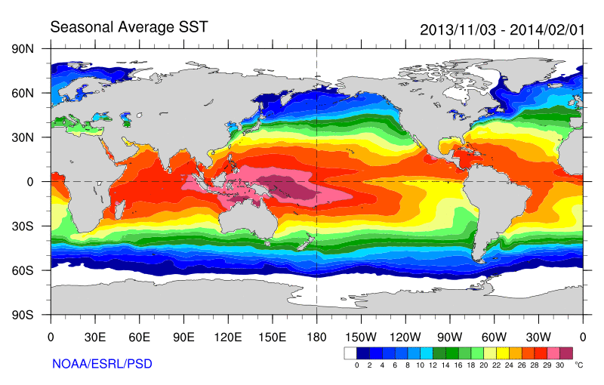
Some earlier strands
Radiative Forcing/Imbalance Johnson et al. (2016) ; Checa-Garcia et al. (2016) ; Huber & Knutti (2014) ;Santer et al. (2015) :
Continued heating from greenhouse gases
Aerosol forcing of circulation (Smith et al. 2016)
Unusual weather patterns (Ding et al. 2014; Trenberth et al. 2014b)
Pacific SST strengthens atmospheric circulation
Enhanced Walker Circulation
? Heat flux to Indian ocean Lee etal 2015
Increased sea height
Warm
Upwelling,
Cool water
Remote forcing from Atlantic:
Li et al. (2016) ;
McGregor et al. (2014)
Increased precipitation
Decreased salinity
Strengthening trade winds
Equatorial Undercurrent
Pacific dominates?
Mann et al. (2016) Kosaka & Xie (2013) England et al. (2014)
Enhanced mixing of heat below 100 metres depth by accelerating shallow overturning cells and equatorial undercurrent
See also: Merrifield (2010).; Sohn et al. (2013) .; L’Heureux et al. (2013) . Change; Watanabe et al. (2014) ; Balmaseda et al. (2013) ; Trenberth et al. (2014) .; Llovel et al. (2014) ;Durack et al. (2014) ; Nieves et al. (2015) ; Brown et al. (2015) JGR ; Somavilla et al. (2016) ; Liu et al. (2016)
Notes:
There is lots of new results focussing on the slower rates of surface warming and associated unusual climatic conditions at the beginning of the 21st century (see DEEP-C website: http://www.met.reading.ac.uk/~sgs02rpa/research/DEEP-C.html#PAPERS).

Slide 13
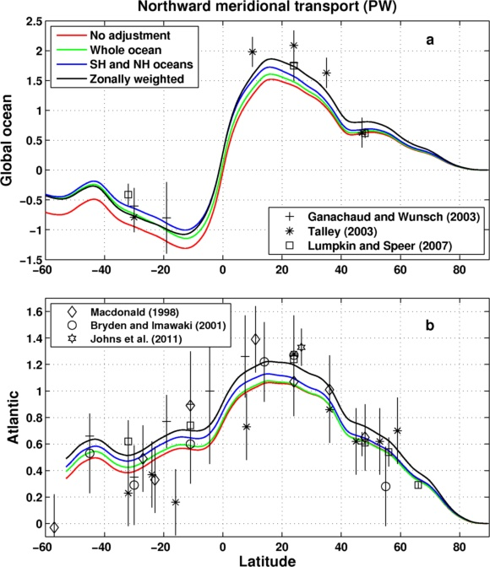
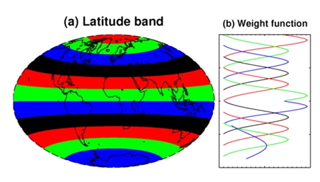
Meridional Heat Transport Estimate
Inferred from DEEP-C surface energy flux data (Liu et al. 2017 JGR) & ocean heating (Roemmich et al 2015) 2006-2013
Sensitivity of method to land flux correction
Zonal land correction
26ºN

Slide 14
Summary
More accurate multi-decadal global estimates of Earth’s energy budget and its variability (e.g. Cheng et al. 2017 Sci. Adv.; Allan et al. 2014 GRL)
  Better indicator of global climate change than surface temperature but gaps in observing deep ocean (e.g. Palmer 2017 CCCR)
  Link to observed cloudiness? e.g. Norris et al (2016) Nature
Link between energy imbalance and surface warming depends on energy budget of upper mixed ocean layer (Roberts et al. 2015 JGR; Hedemann et al. 2017 Nature Climate Change; Xie & Kosaka 2017 CCCR)
  Better appreciation of mechanisms of decadal global climate variability
Distinct feedbacks on internal variability/forced change (Brown et al. 2016 J. Clim; Xie et al. 2015 Nature Geosci; Zhou et al. (2016) Nature Geosci
  Obs. estimates of climate sensitivity (Richardson et al. (2016) Nature Climate)
  Spatial patterns of warming crucial (Gregory and Andrews (2016) GRL)
  What explains decreased heating of E Pacific and is it realistic?
Advances in observing/understanding inter-hemispheric energy imbalance/transport and links to CMIP5 precipitation biases (Frierson et al. 2013; Loeb et al. 2016 Clim. Dyn; Stephens et al. 2016 CCCR)
  Possible constraint on realism of climate models (Haywood et al. (2016) GRL)

Slide 15
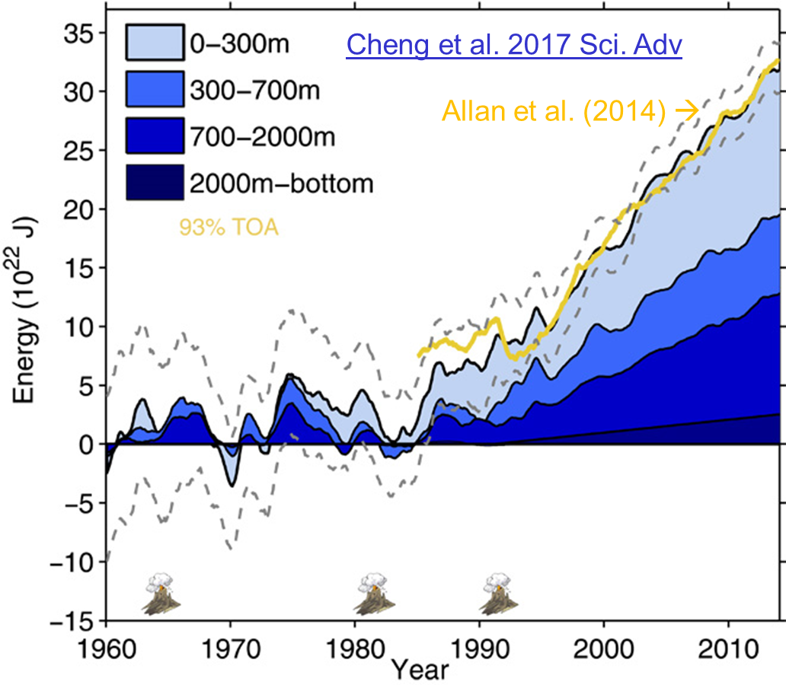
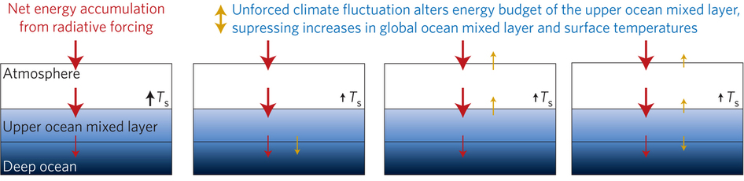
Improved global energy imbalance estimates
More accurate global imbalance from ocean and satellite observations: Cheng et al. 2017:
Steady decadal ocean heating since 2000: 0.6-0.8 Wm⁻² (Johnson et al. 2016)
Radiative forcing/internal variability influence TOA radiation (Palmer/ McNeall 2014; Allan et al. 2014; Huber/Knutti 2014; Xie/Kosaka 2017)
Upper ocean heat budget explains surface temperature: Hedemann et al. 2017 NatureCC
Allan (2017) Nature Climate Change
Notes:
Improved and longer records of ocean heating and top of atmosphere radiation measurements have improved estimates of Earth’s energy imbalance and its changes over recent decades.
Simulations with prescribed observed SST and radiative forcing are able to capture variations in energy budget
Greater appreciation for the role of internal variability in influencing global energy budget and the link between energy imbalance and surface temperature via heat budget of upper ocean

