Slide 1
ST2.2: Large-scale atmospheric drivers
Richard Allan
Proposal: Compact KE activity (3 months):
communicate SINATRA work on FFIR precursor indices
contribute to flood risk tool
define optimal index/lead times
To discuss: Since key scientist involved (Adrian Champion) is not joining TENDERLY and SINATRA ST1.3 outputs are ongoing, what is the most profitable use of this resource?
Brief update of finalised and ongoing outputs…
Notes:
Top right: atmospheric moisture amount (colours, mm) with arrows showing enhanced moisture transport leading up to the 26 June flooding event. Bottom rigtht shows a composite of water vapour (kg/kg, colours), enhanced moisture transport (arrows) and sea level pressure for summer heavy rainfall events in the South East. You can also mention we will use a range of precursors, including atmospheric stability metrics such as equivalent potential temperature, each with their optimal lead time and region-specific characteristics.

Slide 2
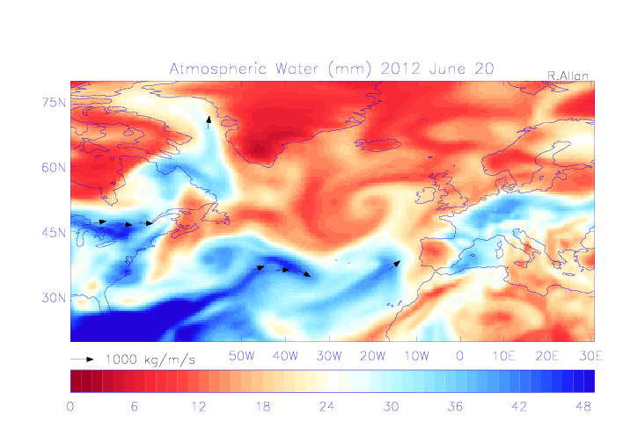
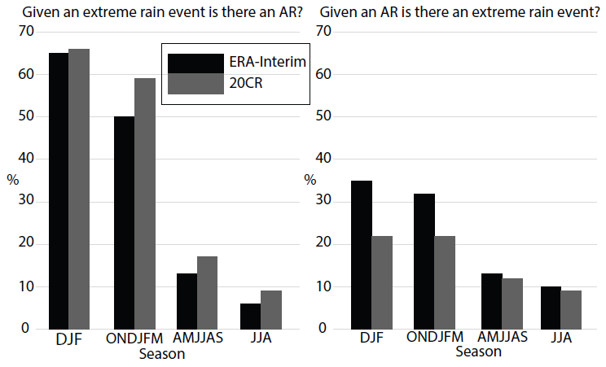
SINATRA ST1.3 advances
Development of framework for analysing links between precursors/events
Atmospheric rivers/intense moisture transport situations less important for summer flooding (as expected)
Extreme event?
Atmospheric precursor?
Champion et al. (2015) JGR
Allan et al. (2015) IJOC
Notes:
Top right: atmospheric moisture amount (colours, mm) with arrows showing enhanced moisture transport leading up to the 26 June flooding event. Bottom rigtht shows a composite of water vapour (kg/kg, colours), enhanced moisture transport (arrows) and sea level pressure for summer heavy rainfall events in the South East. You can also mention we will use a range of precursors, including atmospheric stability metrics such as equivalent potential temperature, each with their optimal lead time and region-specific characteristics.

Slide 3
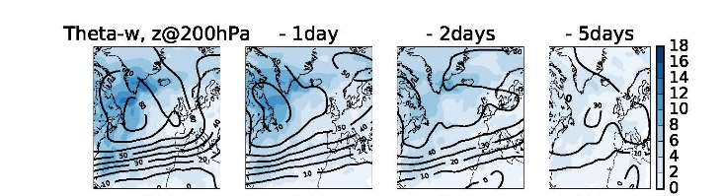
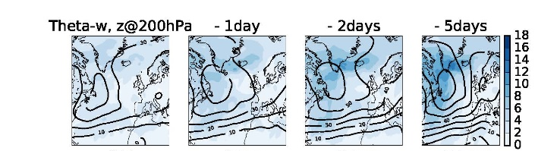
Ongoing: investigating links between 3HR JJA rainfall extremes &
Geopotential anomalIES in NW Atlantic
NW events
SE events

Slide 4
Ongoing: local thermodynamic fields
Td, PMSL (contours)
Evaporation
CWV, →WVT
t - 4 days
+
CWV
t – 2
+
+
+
Composite of 2000 heaviest JJA 3hr rainfall events (SE)
t – 0
+
+
+

Slide 5
Ideas for tenderly work
To discuss…
  KE to communicate finalised SINATRA work to FFC/EA as planned
3 months to extend SINATRA work to usable outputs?
  add to existing PDRAs tasks, e.g. Newcastle PDRA in collaboration with Reading
  Apply precursor diagnostics:
    TENDERLY case studies
    Flood events/impacts rather than intense rainfall?

