Slide 1
Analysis of Cyclone Friedhelm, 8 December 2011 (DIAMET IOP-8)
Laura Baker, Oscar Martinez-Alvarado, Sue Gray, John Methven, Nigel Roberts, Bob Plant

Slide 2
Overview
Planning to write paper on: Characterization of the multiple sting jets in cyclone Friedhelm (title TBC)
Key components:
  Comparison between aircraft observations and model data
  Using a moisture tracer diagnostic to clarify the role of evaporation
  Study of the evolution of the sting jet, affecting low-level winds over a 12-hour period
  Investigation of the relationship between the SJ and the CCB and other strong jets

Slide 3
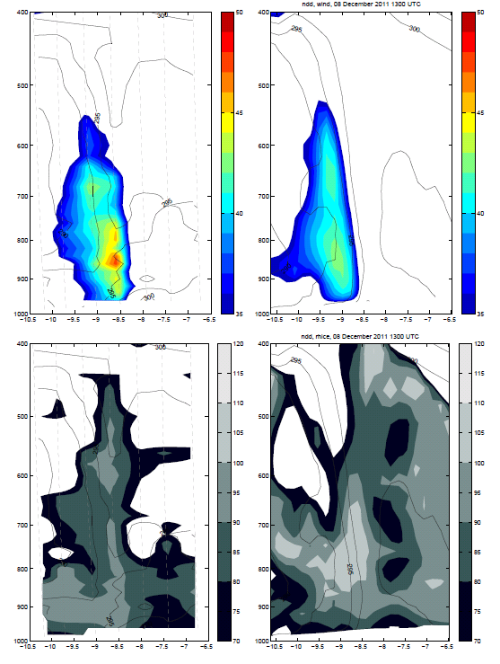
Comparison between aircraft observations and model data
Dropsondes 11-17
Model at 1300UTC
1300 UTC
Wind speed
in m s⁻¹
Thin lines are θ_{e} isolines
Relative humidity (wrt ice)
in %

Slide 4
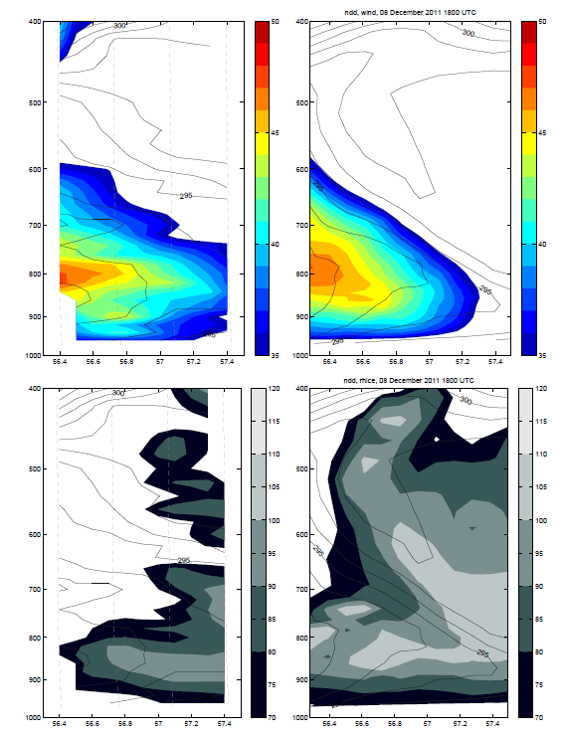
Comparison between aircraft observations and model data
Dropsondes 18-22
Model at 1800UTC
1800 UTC
Wind speed
in m s⁻¹
Thin lines are θ_{e} isolines
Relative humidity (wrt ice)
in %

Slide 5
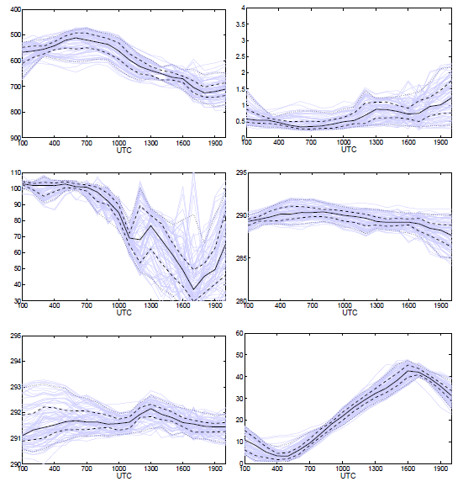
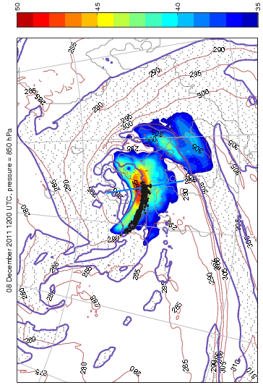

Sting jet trajectories
A sample of many trajectory ensembles with similar characteristics
pressure
specific
humidity
RHice
potential
temperature
$$θ_{e}$$
wind
speed

Slide 6
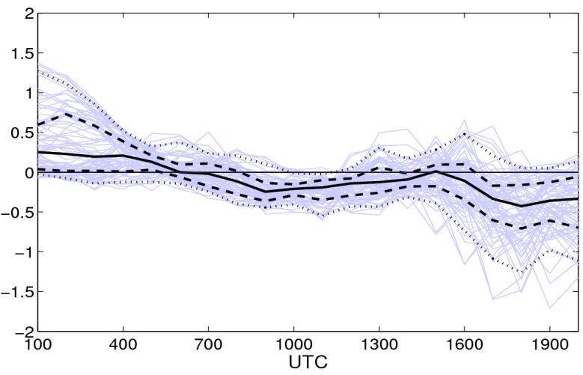
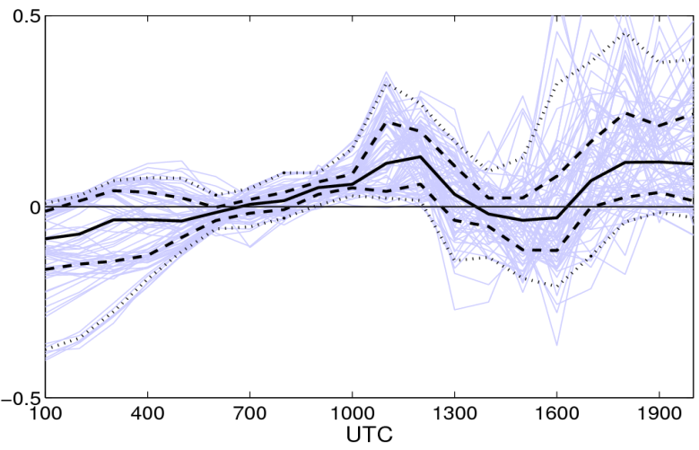
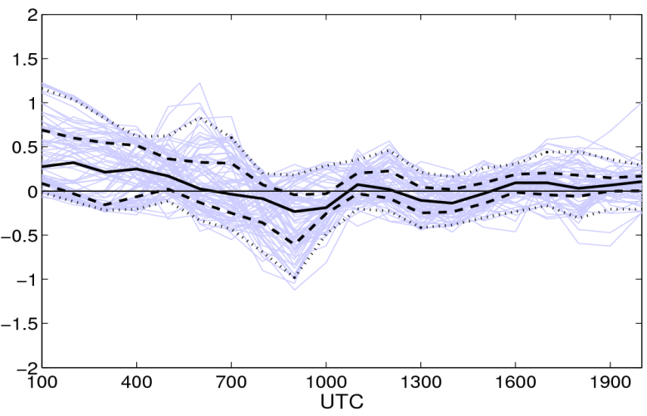
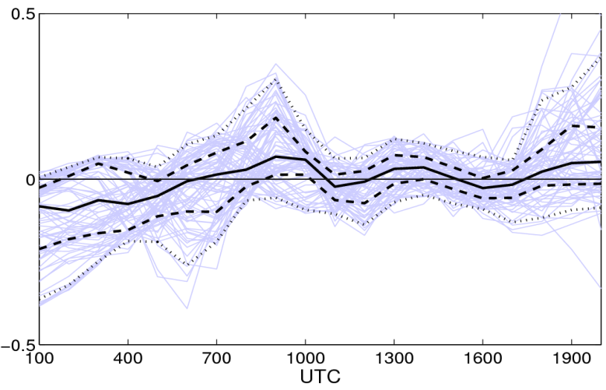
Moisture tracer diagnostic
Rate of change of potential temperature (K h⁻¹)
Rate of change of specific humidity (g kg⁻¹ h⁻¹)
Rate of change of potential temperature due to microphysics and boundary layer schemes (K h⁻¹)
Rate of change of specific humidity due to microphysics and boundary layer schemes (K h⁻¹)

Slide 7
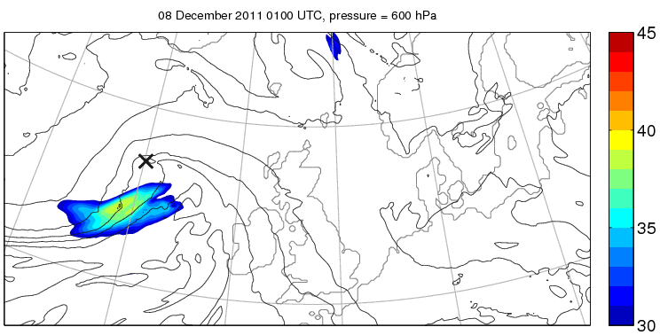
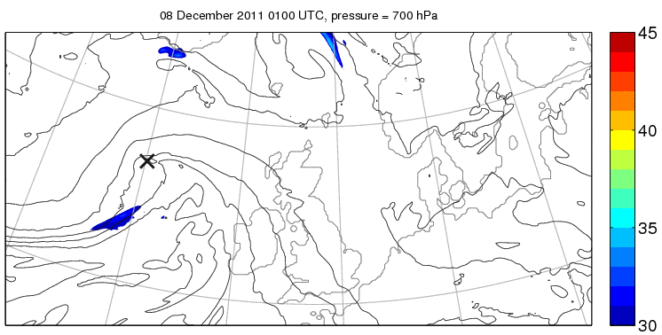
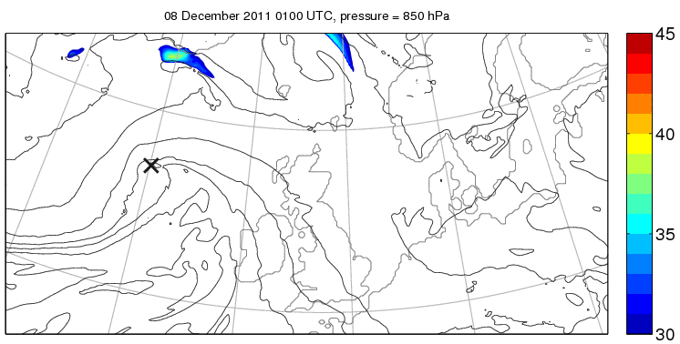
600 hPa
Evolution of strong winds
700 hPa
System-relative winds
System velocity computed as the domain-average 700-hPa velocity
Thin lines represent 850-hPa θ_{e}
850 hPa

Slide 8
700 hPa
700 hPa
0900 UTC

Slide 9
700 hPa
700 hPa
1300 UTC

Slide 10
700 hPa
850 hPa
1800 UTC

Slide 11
MOGREPS-UK ensemble and
UKV simulations

Slide 12
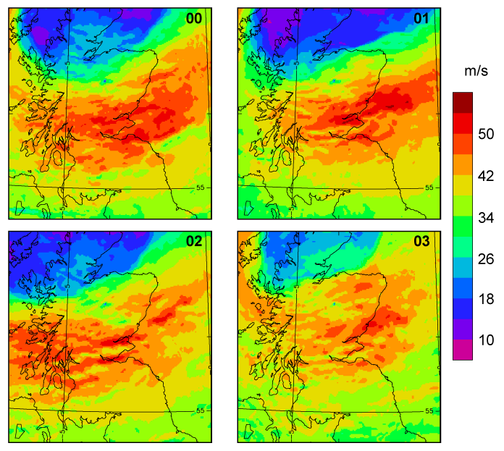
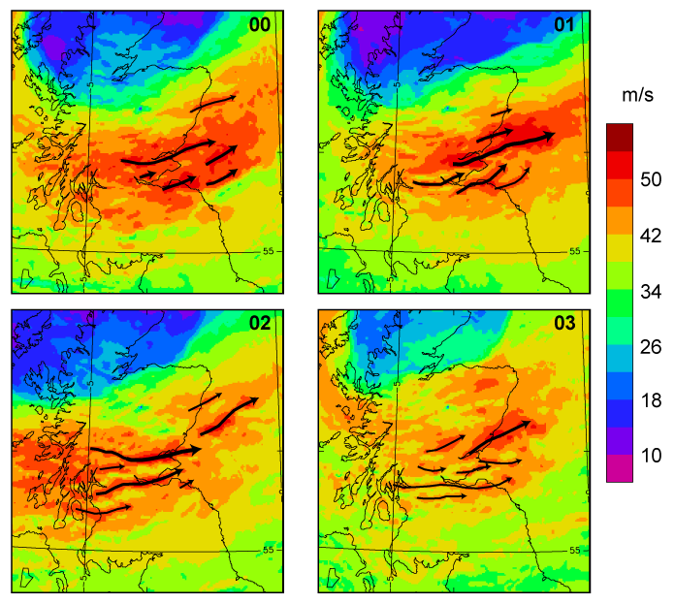
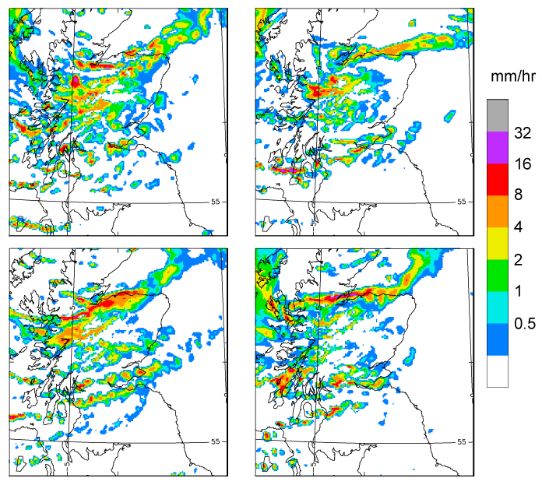
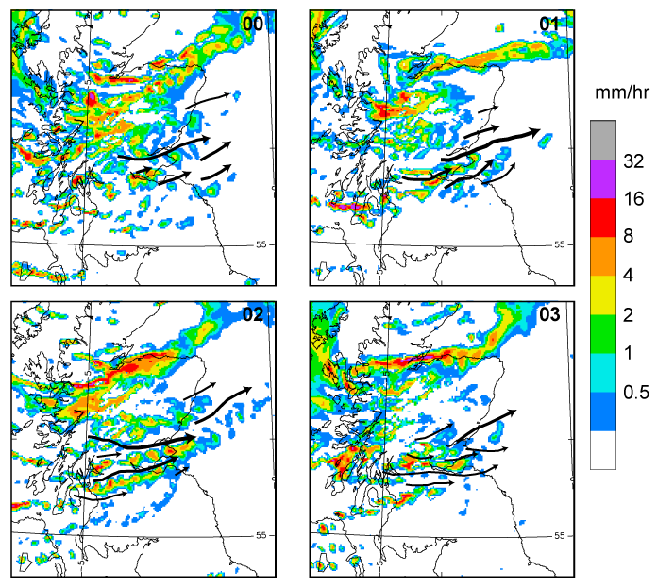
MOGREPS-UK members 0 to 3 16 UTC from 03 UTC
Wind speed 850 hPa
Arrows along high wind cores
and
rain rate
© Crown copyright Met Office
Nigel Roberts
Notes:
12

Slide 13
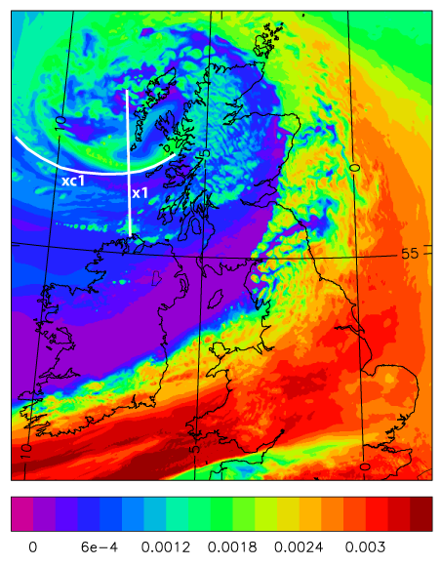
Specific Humidity ~ 4km 11 UTC UKV from 03 UTC
© Crown copyright Met Office

Slide 14
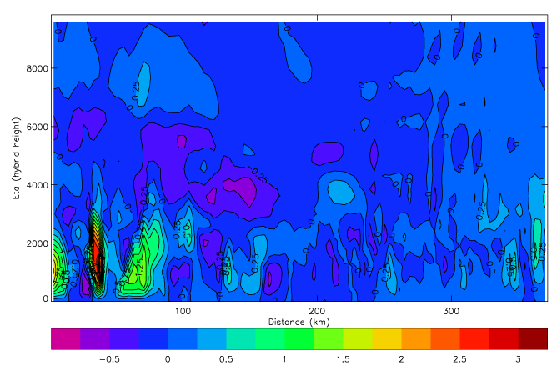
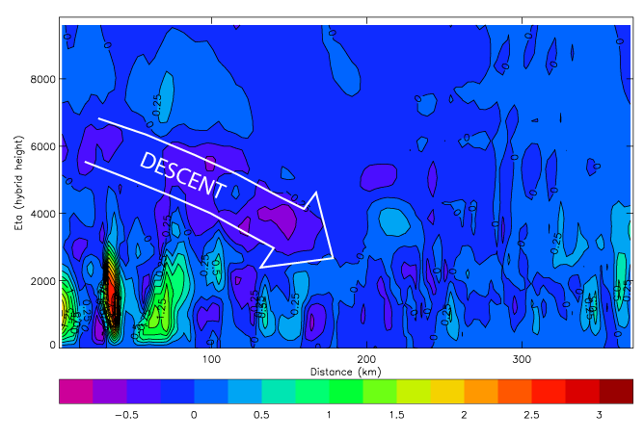
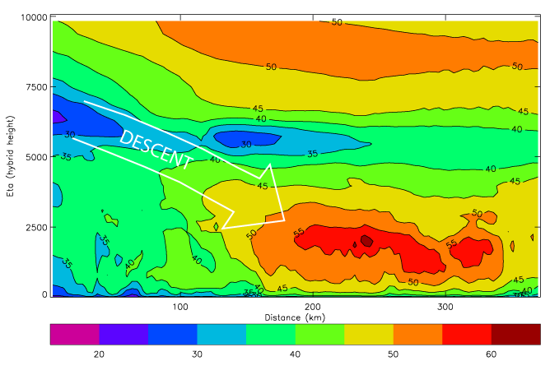
Vertical velocity then wind speed in section xc1 11 UTC UKV from 03 UTC
© Crown copyright Met Office

Slide 15
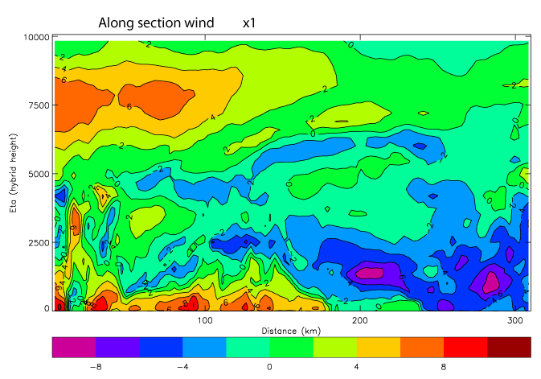
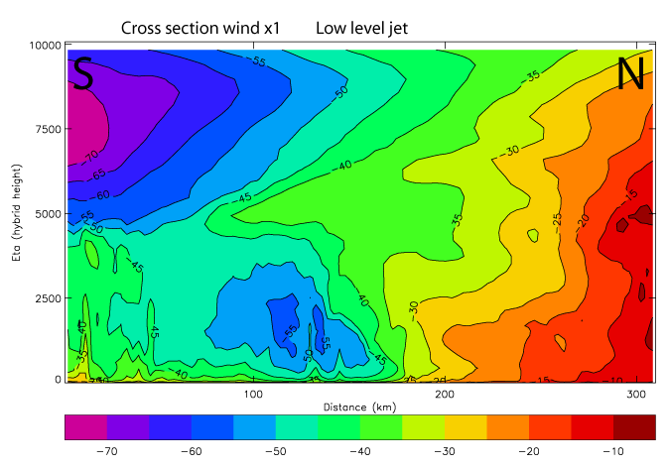
u then v component of wind in section x1 11 UTC UKV from 03 UTC
© Crown copyright Met Office

Slide 16
Additional Slides

Slide 17
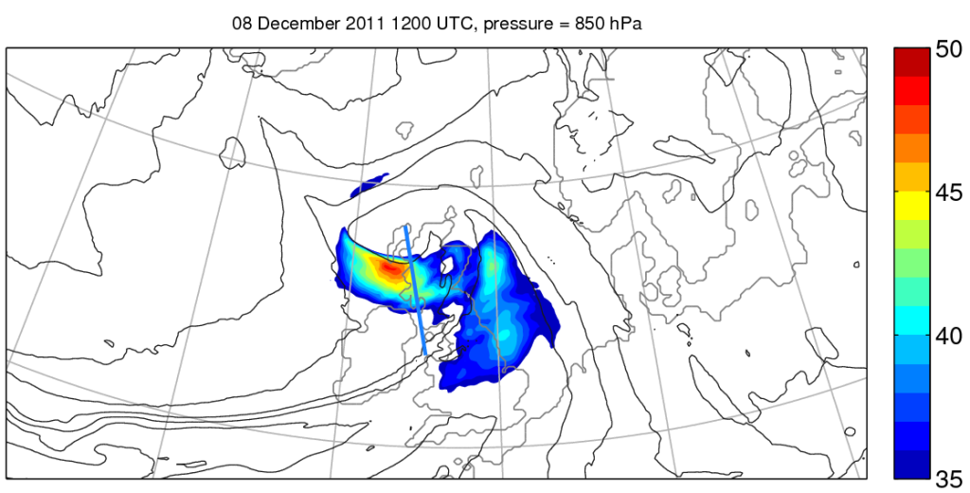
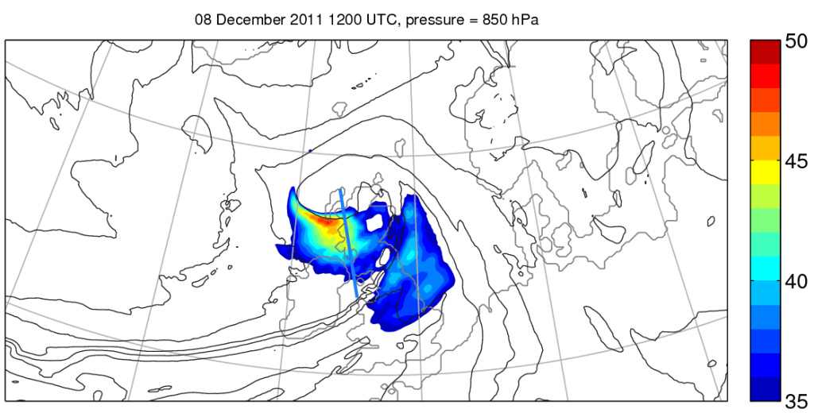
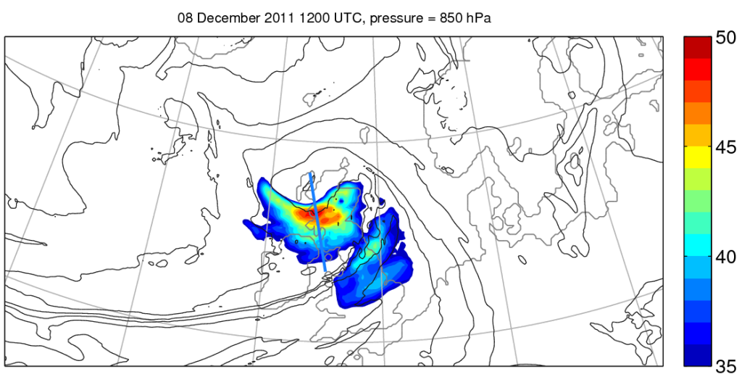
Wind speed
In m s⁻¹
Operational
(T+0)
Operational
(T+6)
Reading simulation (T+12)

Slide 18
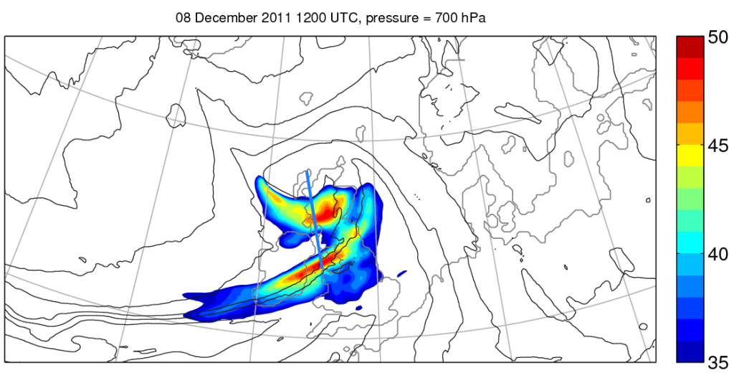
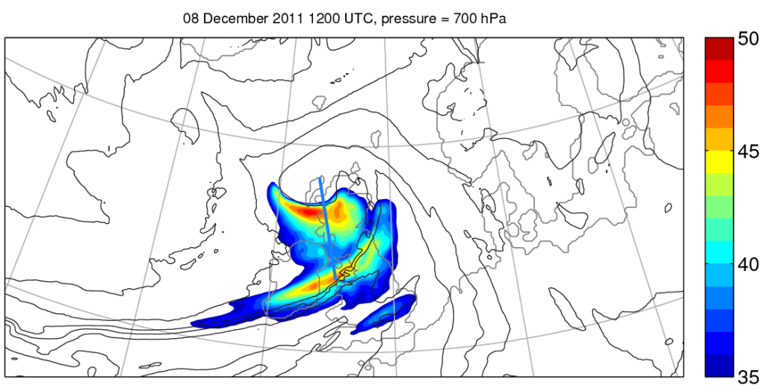
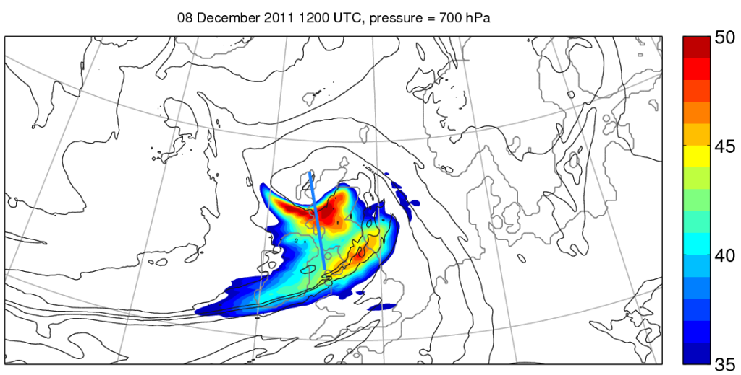
Wind speed
In m s⁻¹
Operational
(T+0)
Thin lines:
θ_{e} isolines in K
Operational
(T+6)
Reading simulation (T+12)

Slide 19
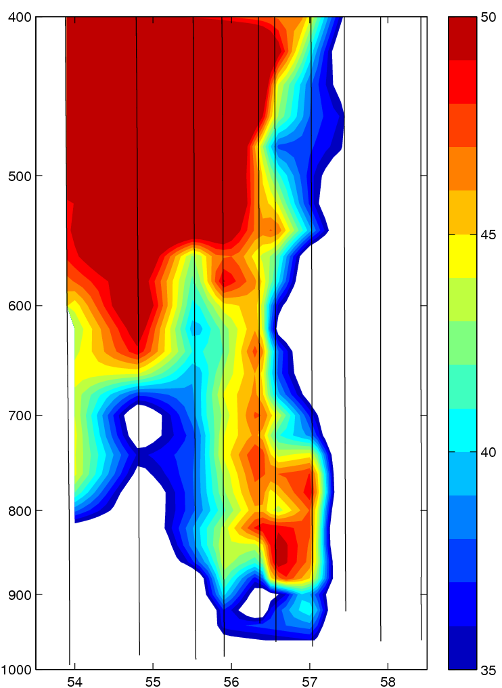
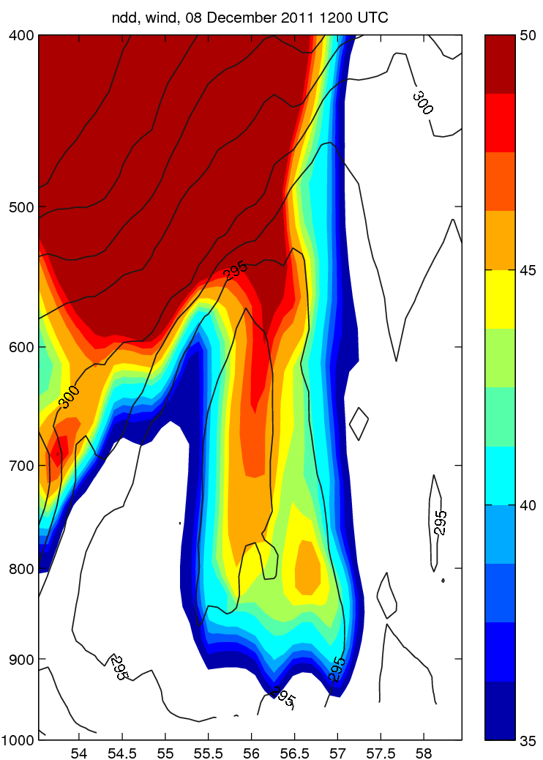
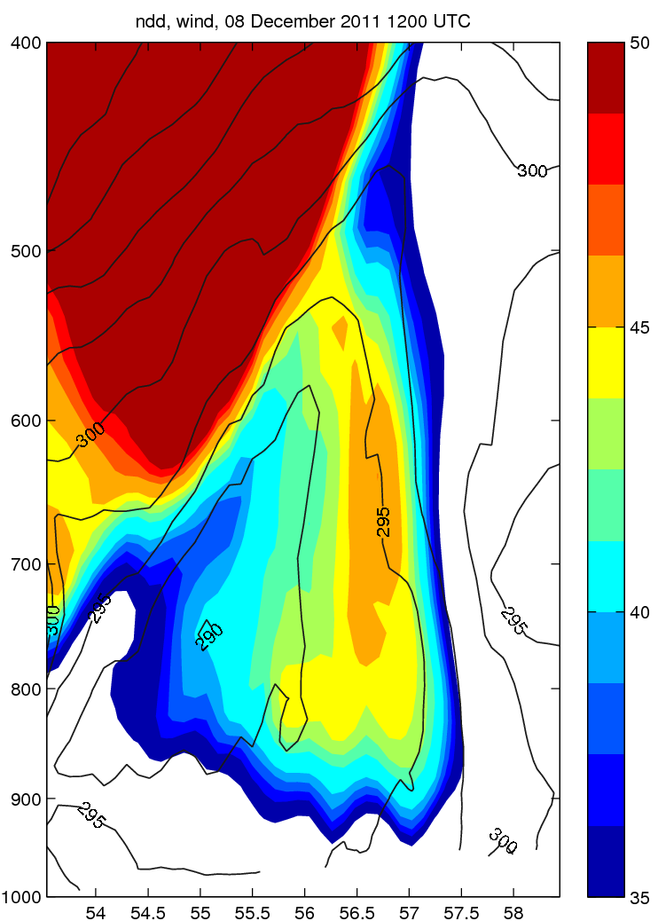
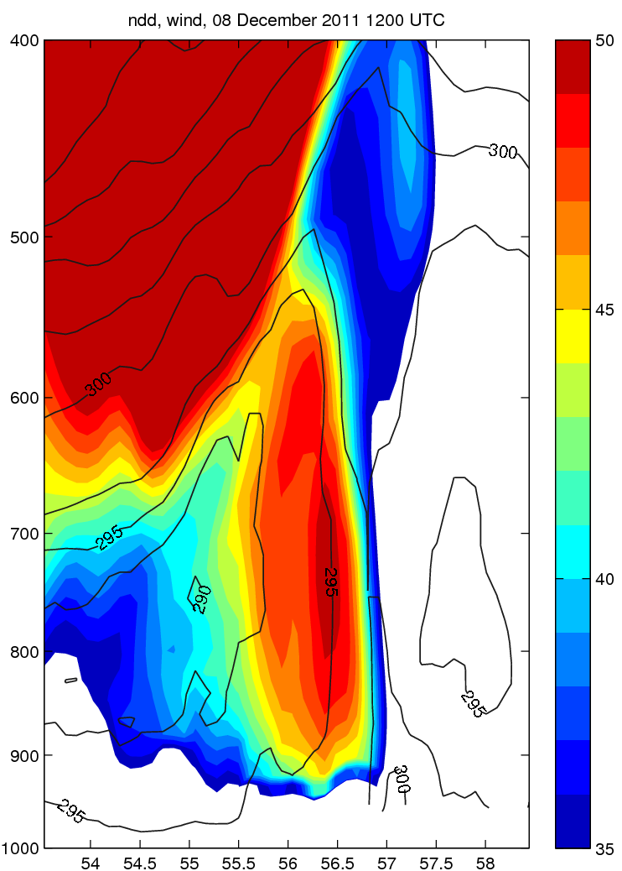
Dropsondes
1-10
Operational
(T+0)
Operational
(T+6)
Reading simulation (T+12)
Colour - Wind speed in m s⁻¹
Thin lines - θ_{e} isolines in K

Slide 20
700 hPa
700 hPa
1200 UTC

Slide 21
700 hPa
700 hPa
1700 UTC

