Slide 1
“New tools for the evaluation of convective scale ensemble systems”
Seonaid Dey
DIAMET meeting
7^{th-8th} March 2011
Supervisors: Bob Plant, Nigel Roberts and Stefano Migliorini

Slide 2
Introduction
Project aims
Case study of 08/07/2011
Current work
Future plans

Slide 3
Project aims
Link statistical measures such as multivariate covariances with physical processes and spatial verification measures
Investigate how deterministic techniques can be extended to ensembles
Look into meteorological aspects and scales that are useful for determining predictability

Slide 4
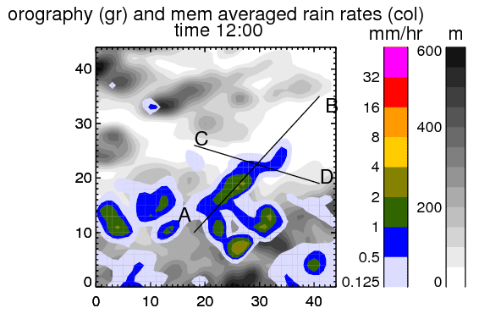
Work so far 1: 08/07/2011
Convective precipitation
Flooding
MOGREPS-UK 2.2km 12 member ensemble

Slide 5
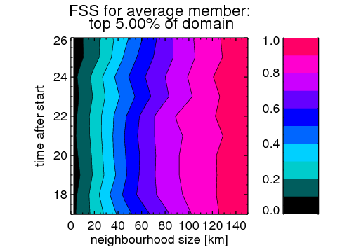
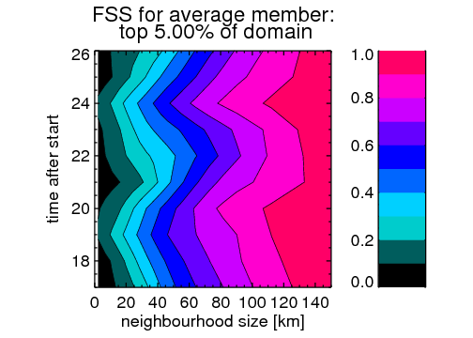
Work so far 2: Spatial measures
Fractions skill score (FSS)
            1- perfect match
            0- totally different
All member pairs
Member-radar pairs

Slide 6
Work so far 3: correlations
Vertical (spatial) correlations
3D Fields:
Horizontal Divergence
Horizontal wind speed
Rain rates
Wind shear
z
Field 1
Field 2

Slide 7
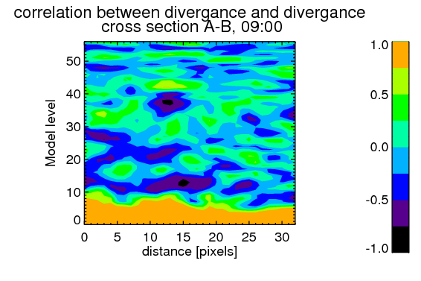
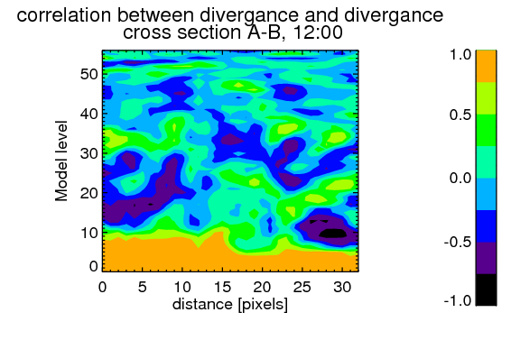
Work so far 4: example correlation
09:00- Before precipitation
12:00 - During precipitation

Slide 8
Next steps
Spatial horizontal correlations
Relate correlations to spatial measures
Spatially varying FSS
Other cases
    Large scale forcing (DIAMET)
    Local forcing (COPE)

