Slide 1
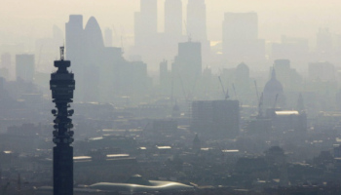


High-resolution Modelling of the Boundary Layer and Implications for Urban Air-quality Forecasting
RMetS Atmospheric Science Conference 2018
Lewis Blunn
Supervisors: Dr Omduth Coceal (NCAS), Prof Bob Plant (UoR), Prof Janet Barlow (UoR), Dr Sylvia Bohnenstengel (Met Office) and Dr Humphrey Lean (Met Office)
Funding: NCAS Air Quality Studentship and University of Reading

Slide 2
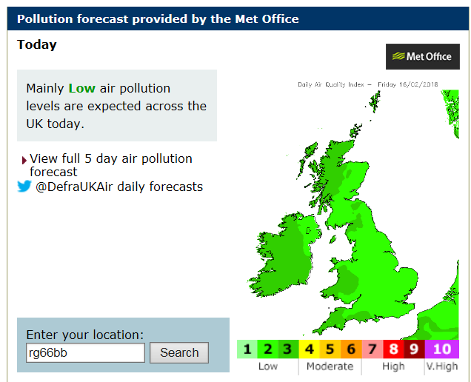
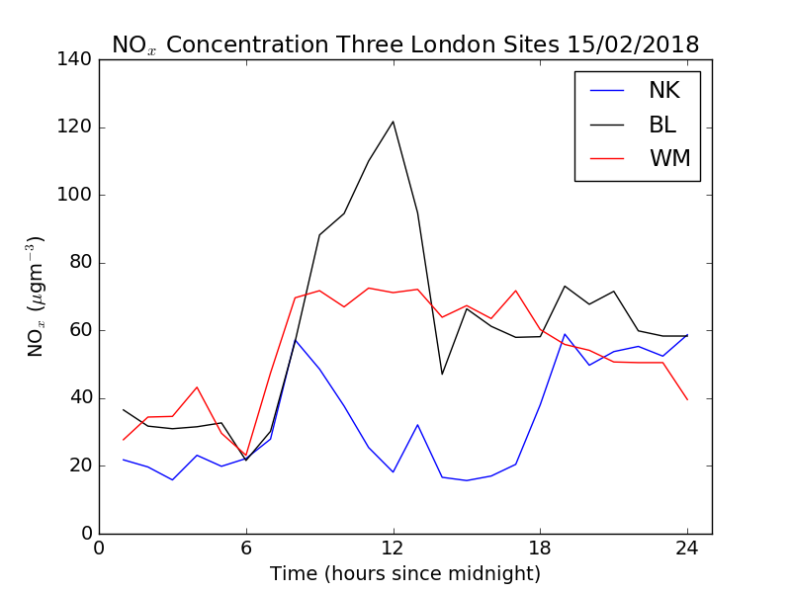
motivation
Current UK Met Office air-quality forecast 12 km resolution
Urban air quality forecasts at the neighbourhood scale
Why?
  Urban planning and air-quality regulation
  Informed health decisions
https://uk-air.defra.gov.uk/

Slide 3
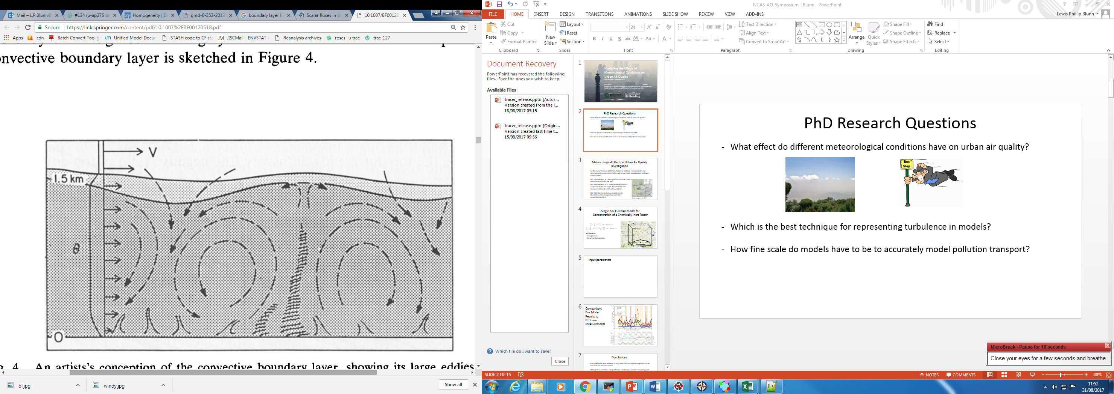

question
How does model resolution in “the greyzone” O(100 m – 1 km) affect representation of meteorological processes in the urban boundary layer?
  Turbulence
  Pollution concentration
~1 km
$∆x$?
Adapted from Wyngaard (1990)

Slide 4
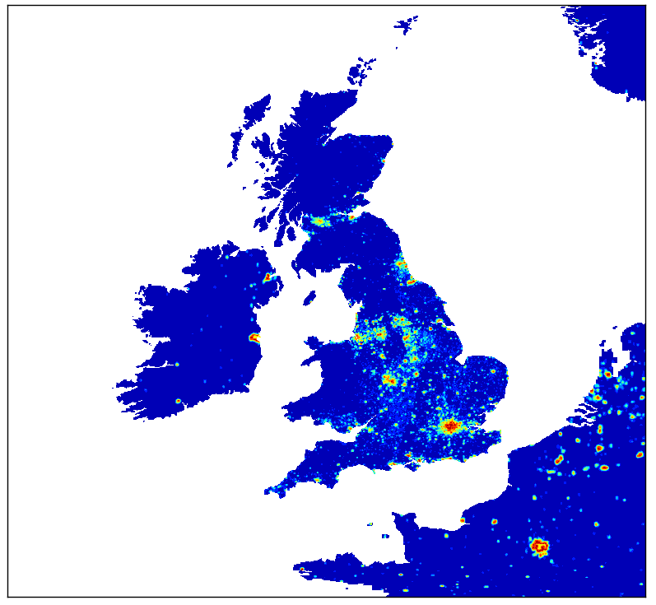
UM Nesting suite
UKV (1.5 km)
Domain ~1392x1116 km
500 m
Domain ~300x300 km
300 m
Domain ~129x129 km
100 m
Domain ~80x80 km
55 m
Domain ~80x80 km
All nests run with MORUSES urban surface scheme (Porson et al. 2010)

Slide 5
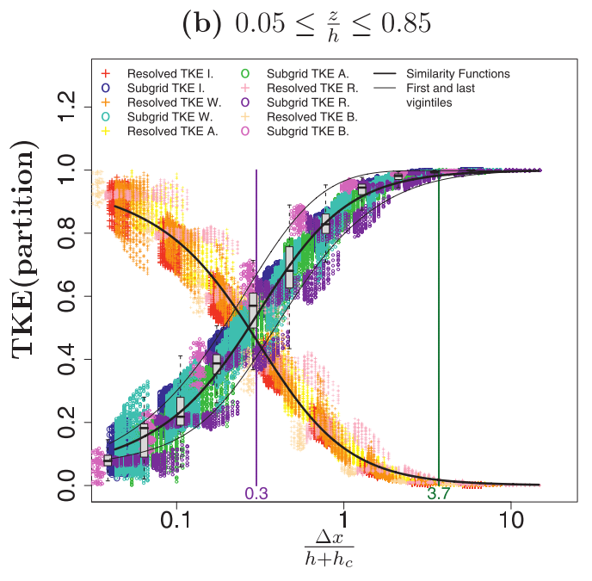
Blending scheme
More turbulence becomes resolved with decreasing grid length.
Fraction of TKE resolved in the mixed layer is used to weight the contribution of parametrised flux.
high-res
55 m, 100 m
greyzone
300 m, 500 m
parametrised
UKV
Adapted from Honnert et al. (2011)

Slide 6
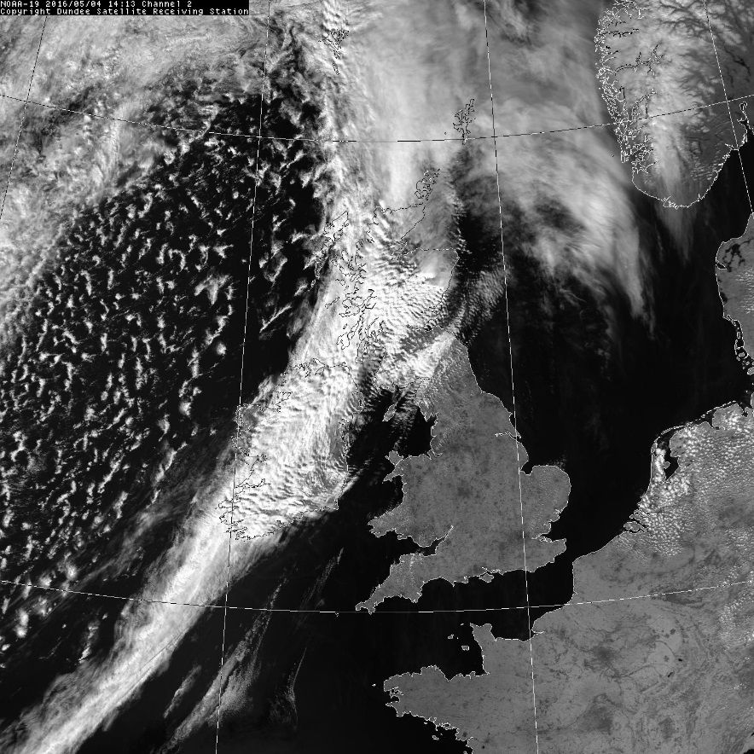
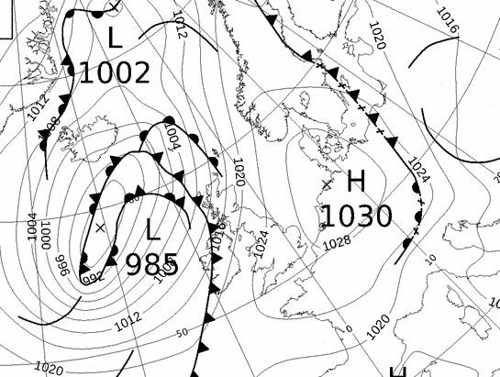
Case study – 04/05/2016
Near infra-red, 0.725-1.10 µm at 14:00 UTC
(Courtesy of Dundee Satellite receiving Station).
Surface chart at 12:00 UTC
(Courtesy of www.wetter3.de)
10 m wind at Reading Observatory averaged from 09:00 – 17:00 UTC:
2.8 m/s (light breeze)

Slide 7
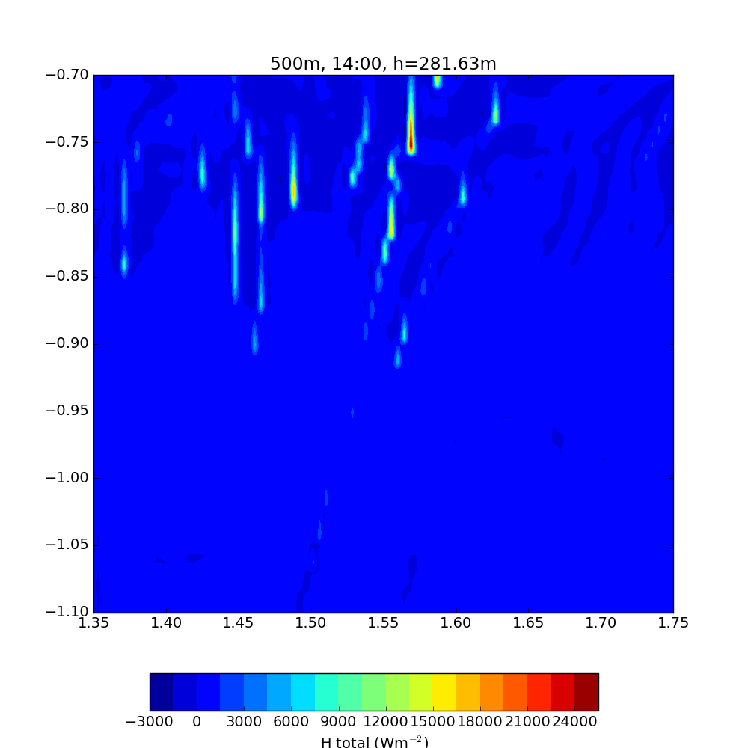
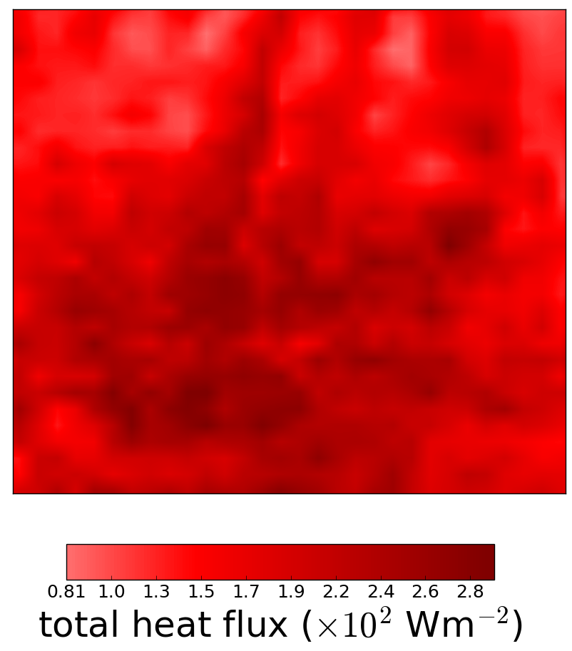
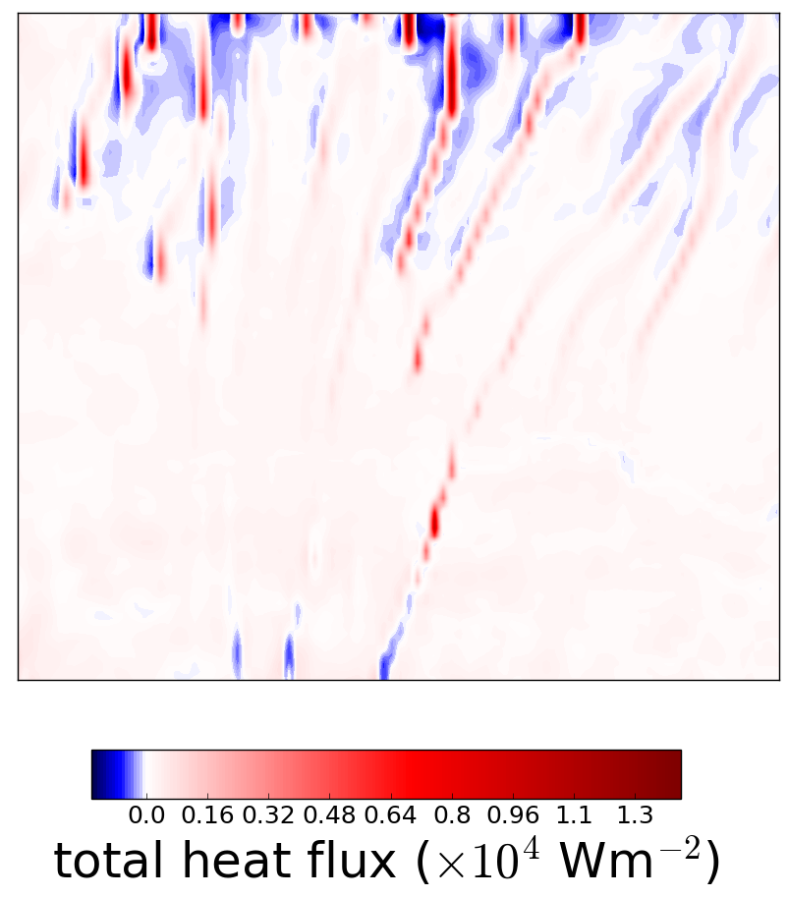
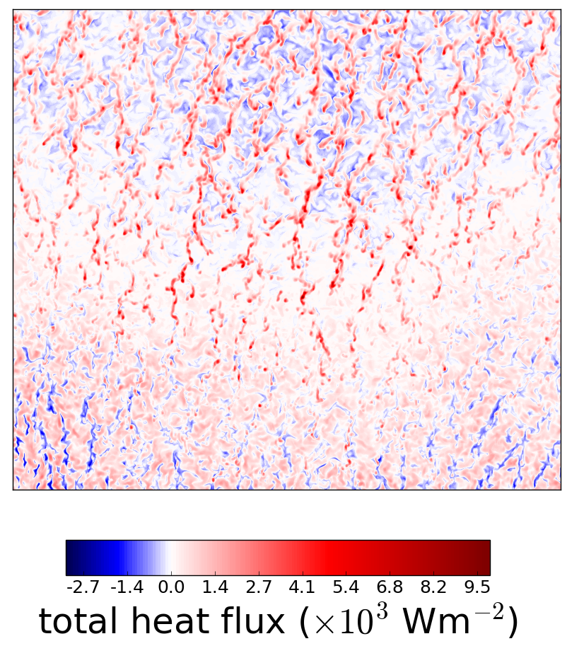
Sensible heat flux
$$H_{total}=ρc_{p}w^{′}θ^{′}+H_{sub−grid}$$
$$H_{resolved}$$
Plots: 14:00 UTC, z = 295 m, area ~ 45 km x 45 km.
UKV
500 m
55 m

Slide 8
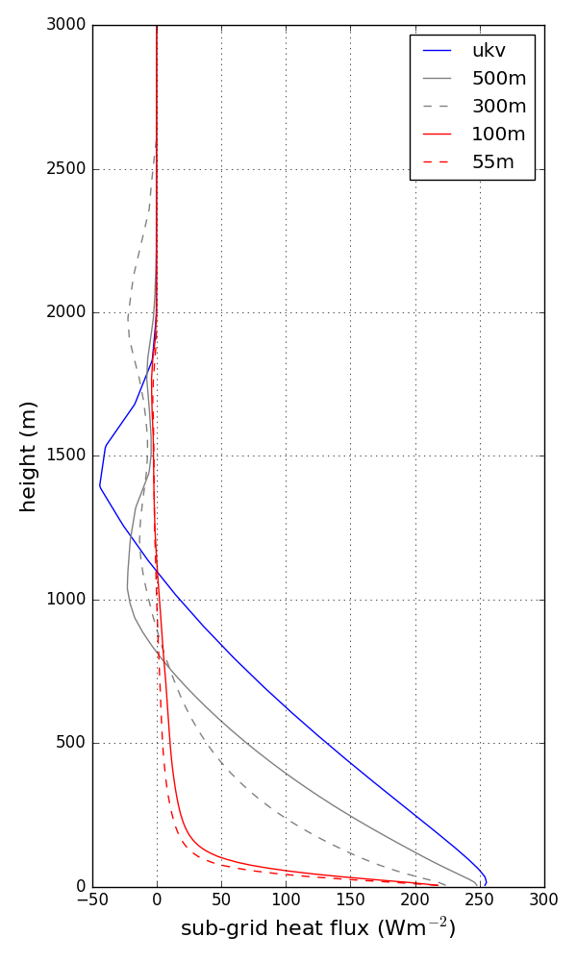
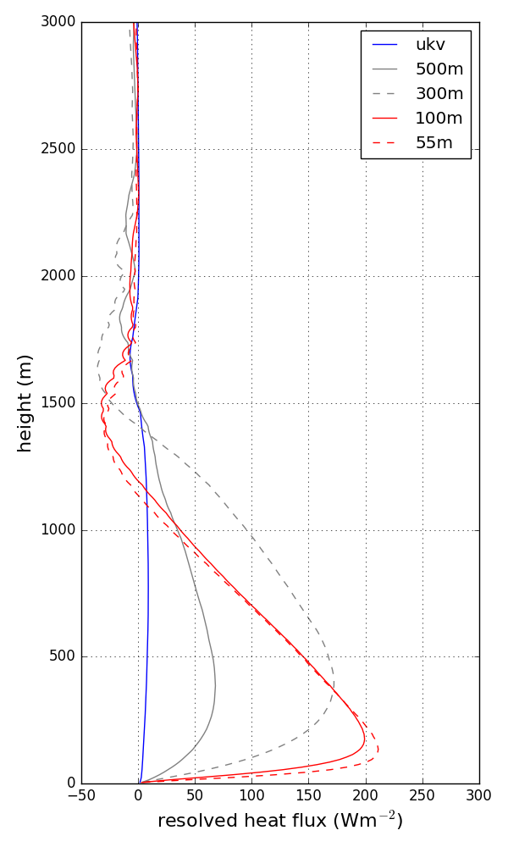
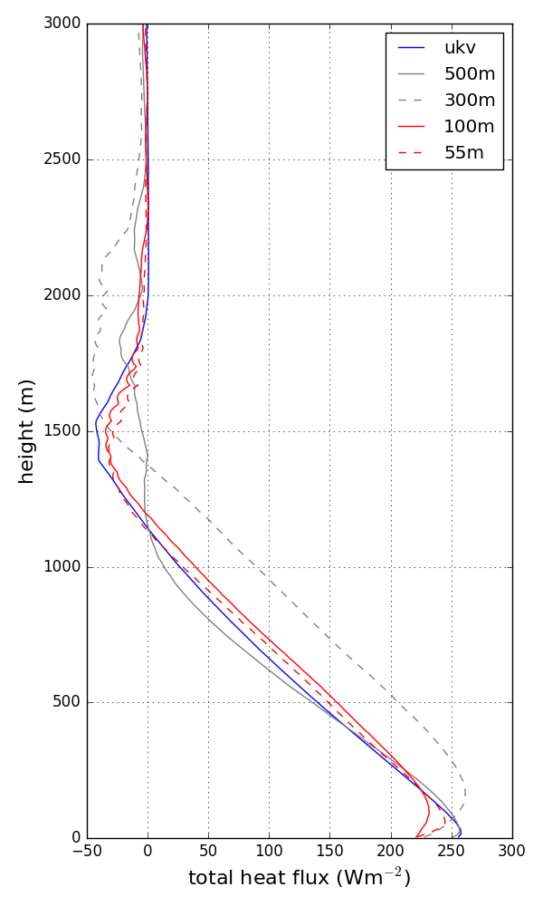
Sensible heat flux
+
=

Slide 9
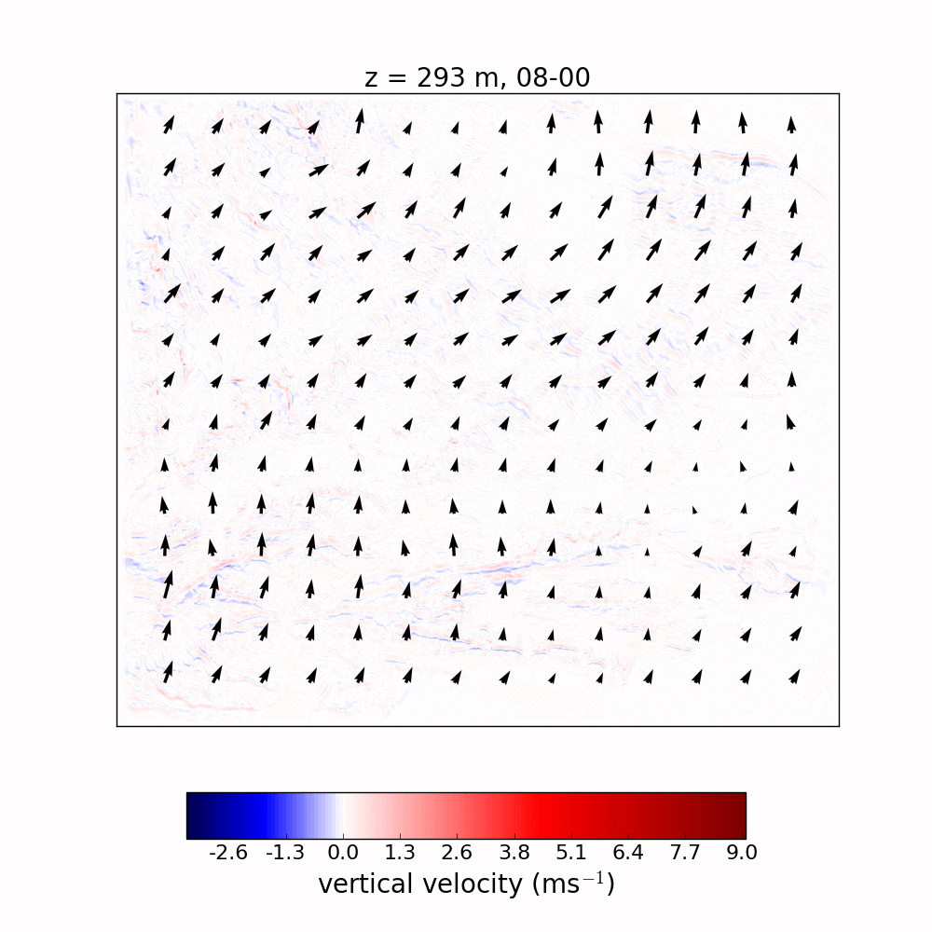
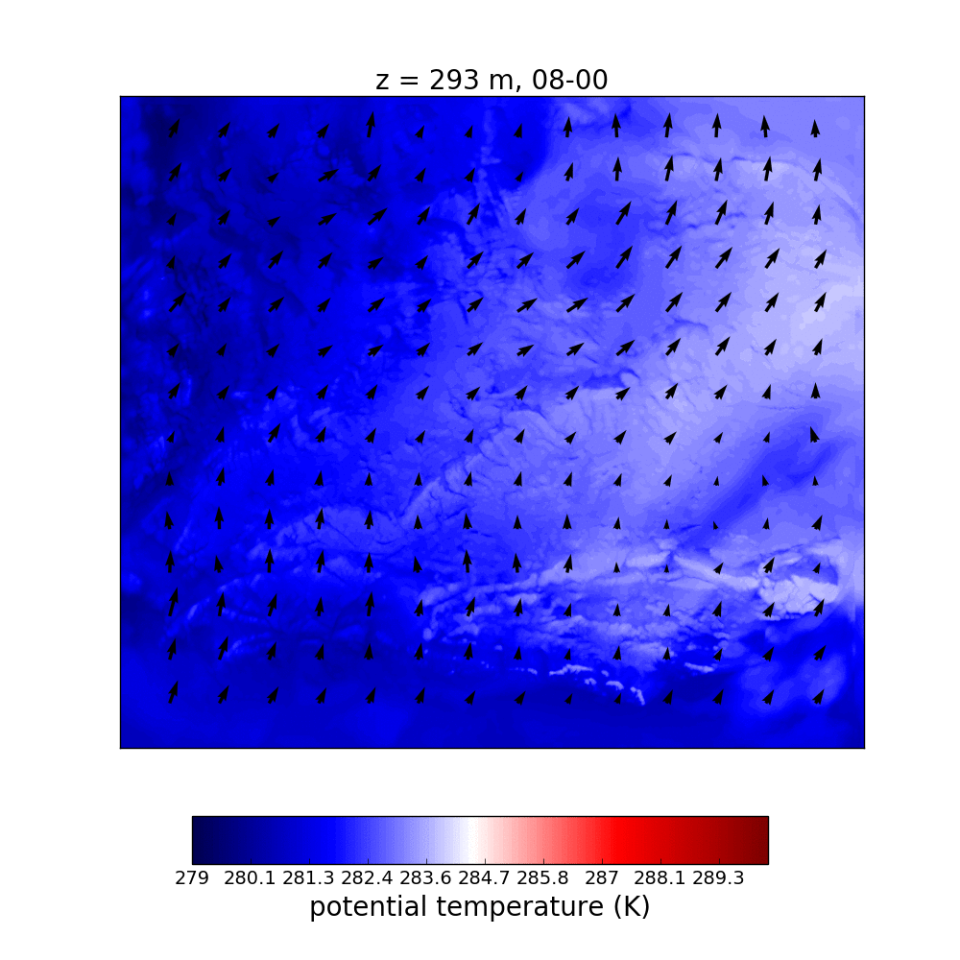


W and $θ$ Fields
Issue in greyzone (300 m, 500 m) with
$$H_{resolved}=ρc_{p}w^{′}θ^{′}$$
500 m grid length:
500 m grid length:

Slide 10
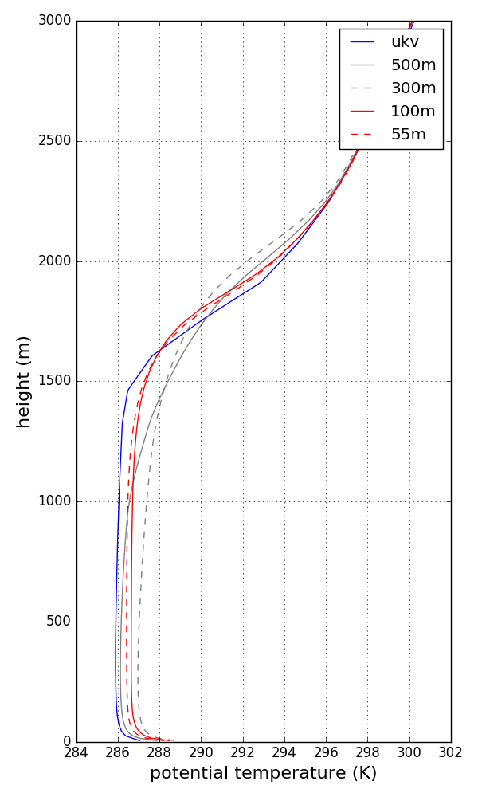
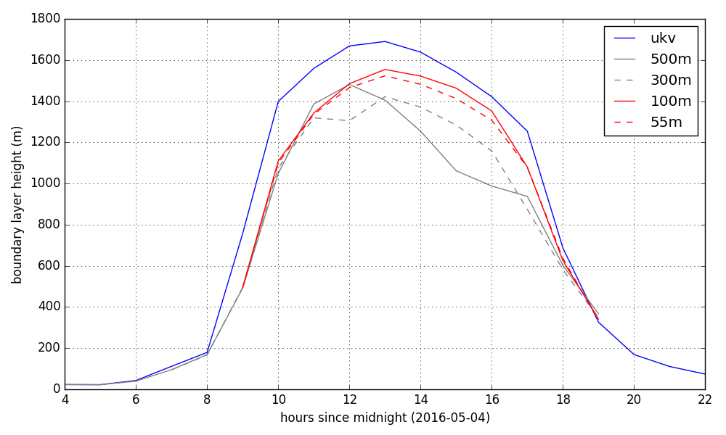

BL height time series and $θ$ profile
10% difference in BL height between UKV and 55 m run
Greyzone BL heights lower – consistent with potential temperature profiles

Slide 11
conclusions
Advise caution when using greyzone for air quality forecasting
Recent Met Office “Blobbiness” report has similar findings
10% difference in BL heights between 1.5 km (UKV) and 55 m runs
  → Translates to approx. 10% difference in tracer concentration
Parametrised (UKV) and high-res (55m,100m) sensible heat flux profiles consistent with each other
Spatial structure of sensible heat flux varies greatly with resolution
  → Pollution fluxes

Slide 12
Thank you
References:
Honnert, R., V. Masson, and F. Couvreux, 2011: A Diagnostic for Evaluating the Representation of Turbulence in Atmospheric Models at the Kilometric Scale. J. Atmos. Sci. 68, 3112–3131.
Porson, A., P.A. Clark, I.N. Harman, M.J. Best, and S.E. Belcher, 2010: Implementation of a new urban energy budget scheme in the MetUM. Part I: Description and idealized simulations. Quart. J. Roy. Meteorol. Soc. 136, 1514 – 1529.
Wyngaard, J.C., 1990: Scalar Fluxes in the Planetary Boundary Layer – Theory, Modeling, and Measurement. Boundary-Layer Meteorology 50, 49–75.
Lewis Blunn
Supervisors: Dr Omduth Coceal (NCAS), Prof Bob Plant (UoR), Prof Janet Barlow (UoR), Dr Sylvia Bohnenstengel (Met Office) and Dr Humphrey Lean (Met Office)

