Slide 1
Convection “Resolving” Models:
How well is the convection actually resolved?
Bob Plant
With thanks to:
Emilie Carter², Peter Clark^{1,2}, Carol Halliwell², Kirsty Hanley^{1,2}, Robin Hogan¹, Dan Kirshbaum^{1,3}, Humphrey Lean², John Nicol¹, Thorwald Stein¹, Rob Warren¹
¹University of Reading ² Met Office ³McGill University
NWP Physics Lecture 6,
Nanjing Summer School,
July 2014

Slide 2
Outline
What is the convective-scale?
Why simulate at the convective-scale?
Comparison with real data
What is realistic looking?
What is right and wrong?
  Cell sizes
  Cell shapes
  Rain rate distribution
  Lifetimes
  Lifecycle
  Vertical structure
Conclusions

Slide 3
What is the convective scale?

Slide 4
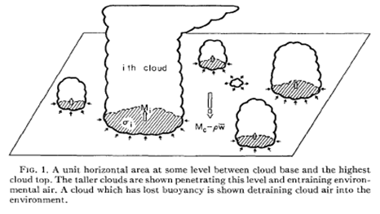
Representation of Convection in Numerical Models
Parameterized
Δx ~ 100km or larger
Many clouds in a grid cell
Represent the effect of all clouds on mean properties of the grid cell
Explicit (large-eddy modelling)
Δx ~ 100m or smaller
Many cells for each cloud
Each cloud full resolved
Grey zone
Δx ~ 1-25 km
Not enough clouds in a cell for parameterization
Not enough cells to resolve individual clouds
Notes:
Grey zone: some clouds may be close to being resolved; there are only a few or even 1 cloud in some boxes and each of these clouds is different; there may be no clouds in some boxes.

Slide 5
Table of Gridlengths
Grid length (km) | Number of models
up to 2 | 2
2-2.5 | 14
2.5-3 | 6
3-4 | 5
4-5 | 3
5-6 | 5
6-7 | 12
7-8 | 3
8-9 | 2
9-10 | 5
10+ | 16
Current operational NWP in Europe
From audit of operational models of
EUMETNET members,
http://srnwp.met.hu/C_SRNWP
project/Eumetnet_List.html

Slide 6
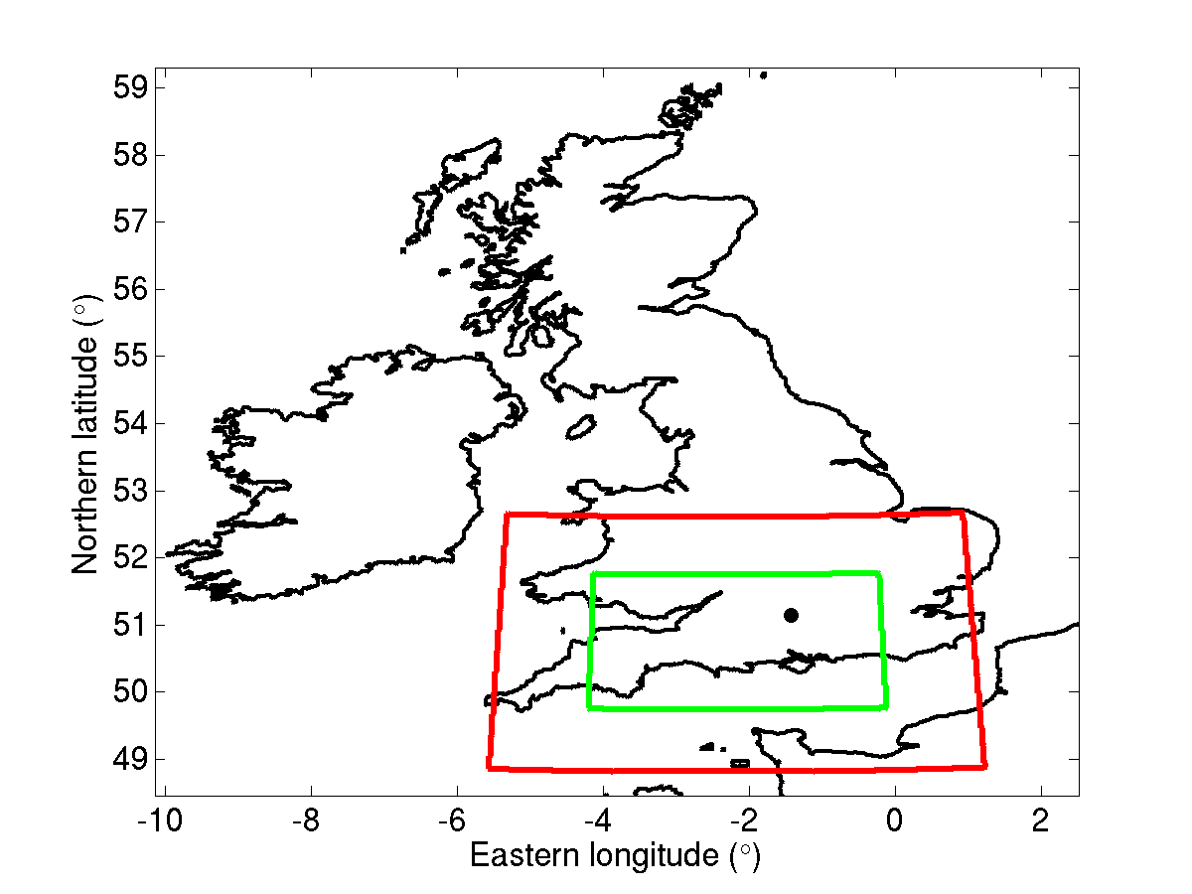
Model setup – UM vn7.8
Set of nested models
UKV – 1.5km grid length
Highest-resolution Met Office forecasting model.
70 vertical levels
Operational since 2009
500m model – 500x425 km, 140 vertical levels
200m model – 300x225 km, 140 vertical levels
Experimental models differ in treatment of boundary-layer turbulence.

Slide 7
Why simulate at the convective scale?

Slide 8
Why run with explicit convection?
Process modelling
“Cloud-resolving” or “cloud-permitting” models have been used for around 20 years for process studies of convection
Many such models are actually in the grey zone and do not have Δx ≪ cloud size
Need to test realism of modelled clouds versus data
What aspects of the clouds are well or less-well captured?
Relatively little attention on comparisons of cloud-level dynamics in a statistical sense

Slide 9
Why track clouds?
Need for lifecycle analyses
1st example: convenient for convective parameterization to assume a steady plume
Implicitly, all the variables appearing within the parameterization are filtered and represent “averages” over a lifecycle
One of the issues in using real data to improve parameterization is the distinction between instantaneous and lifetime-averaged data
May be useful to incorporate lifetime effects in the grey-zone when both explicit and parameterized convection may be active
2nd example: 2nd indirect aerosol effect: aerosol loading could affect lifetime of clouds such as shallow Cu
But systematic statistical information of the effects of microphysical changes on cloud lifetimes is missing

Slide 10
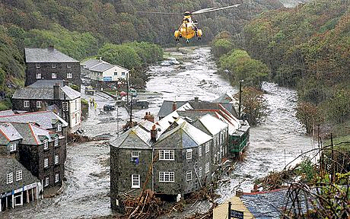
Forecasting, especially for flash floods
Boscastle flood of 16 August 2004
Historically important for UK development of convective-scale NWP
Also good for fog, orographic flows, bush fires

Slide 11
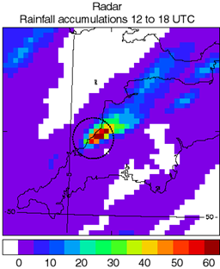
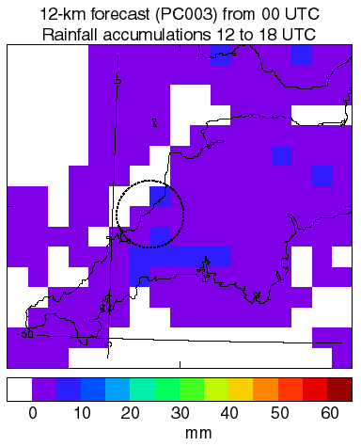
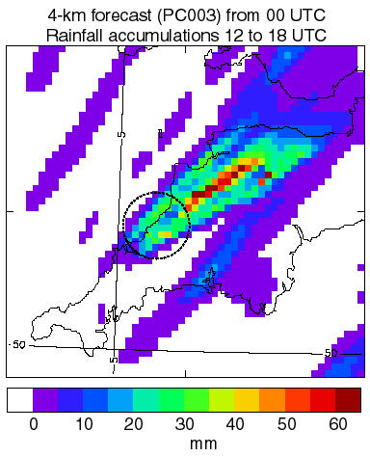
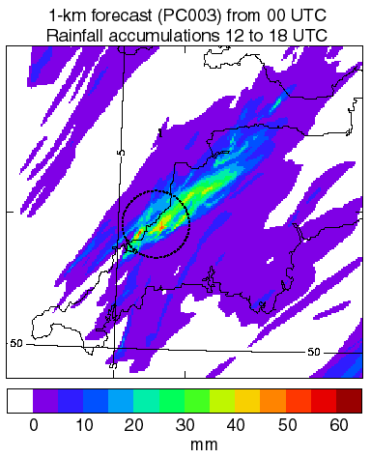
Boscastle Hindcasts
Very good (in this case) at 1km but still errors at cloud scale – too little rain.
Radar observations
on 4 km grid
12 km parameterized
4 km explicit
1 km explicit

Slide 12
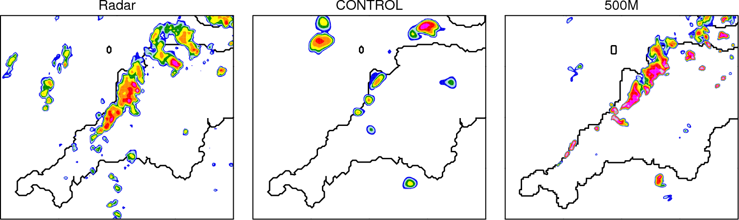
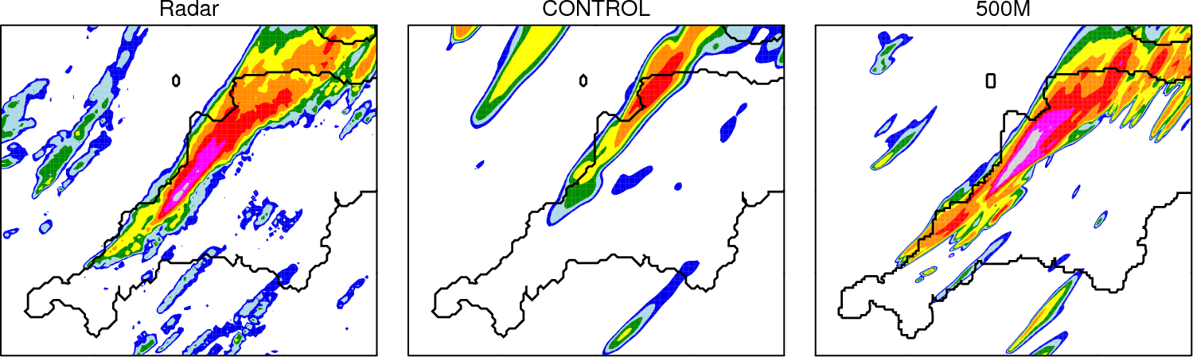
What resolution is needed? 21/07/10

Slide 13
Comparison with Real Data

Slide 14
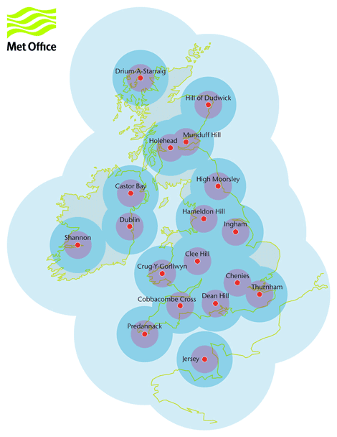
Overview of Nimrod system
16 UK C-band radars (5.6-5.65 GHz, 5cm wavelength)
1x1 km grid, 5min intervals
DYMECS project studies 400x400 km region centered on Chilbolton

Slide 15
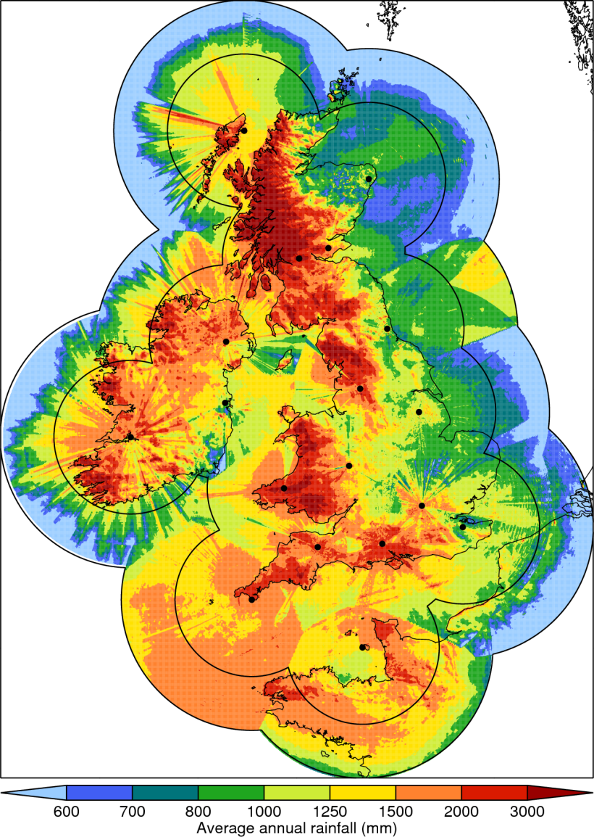
Caveat: Radar data is not perfect
Radar data is our best option for measuring rainfall with good temporal and spatial resolution
But it relies on a statistical relationship between rainfall rate and reflectivity
And is subject to systematic errors
Nimrod data is not perfect
Model data interpolated/aggregated onto radar grid for comparison

Slide 16
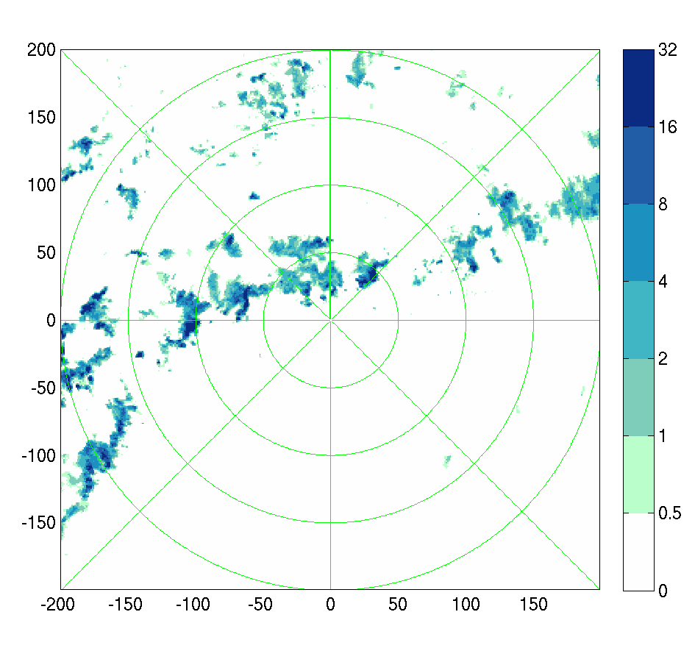
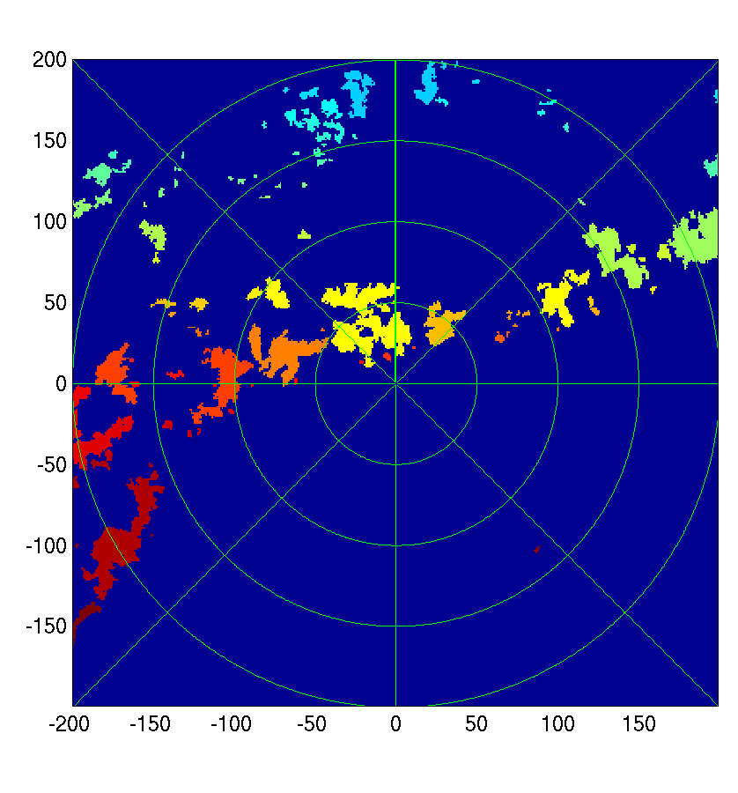
Rainfall region analysis
Set rainfall threshold (1mm/h) and minimum area (4km²) for regions to be labelled
NB: We apply the same algorithms to the model data for like-for-like comparison

Slide 17
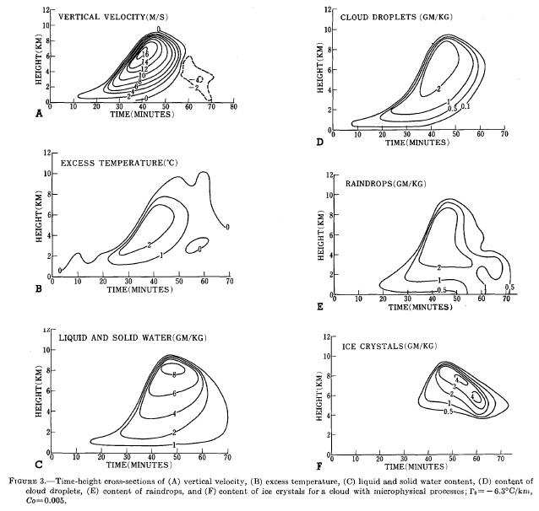
Convective Region Identification
Identification issues:
(eg Ogura and Takahashi 1971)
Different definitions focus on different aspects of cloud
visual impression ≠ radar image ≠
w threshold

Slide 18
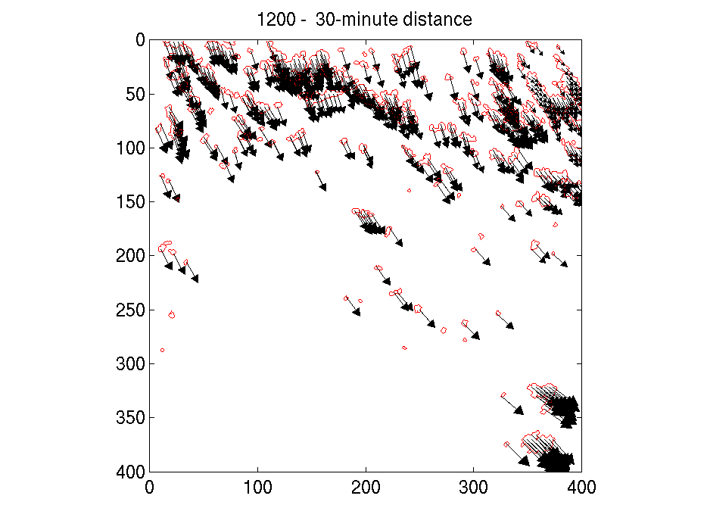
Tracking storms
Use correlation method to track displacement between Nimrod rainfall images at larger scale
Project S0 to next time using velocity field
Check for overlap with storms in new Nimrod image to track storm
S0
S1

Slide 19
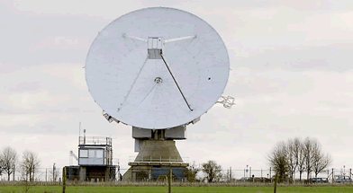
Chilbolton data
S-band radar (3 GHz, 10cm wavelength)
2deg/s azimuth rate
0.4 deg/s elevation rate
300m range gate
200km range

Slide 20
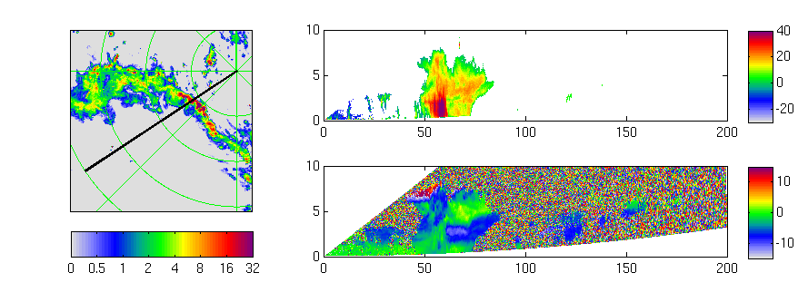
Prioritizing Storms
Sweet spot for RHI scans
Too near:
Miss tops of storm or
takes too long to finish RHI
Reflectivity
Height
Radial winds
Height
Rainfall
Distance from radar
Too far:
Miss low-level precipitation
and coarser resolution

Slide 21
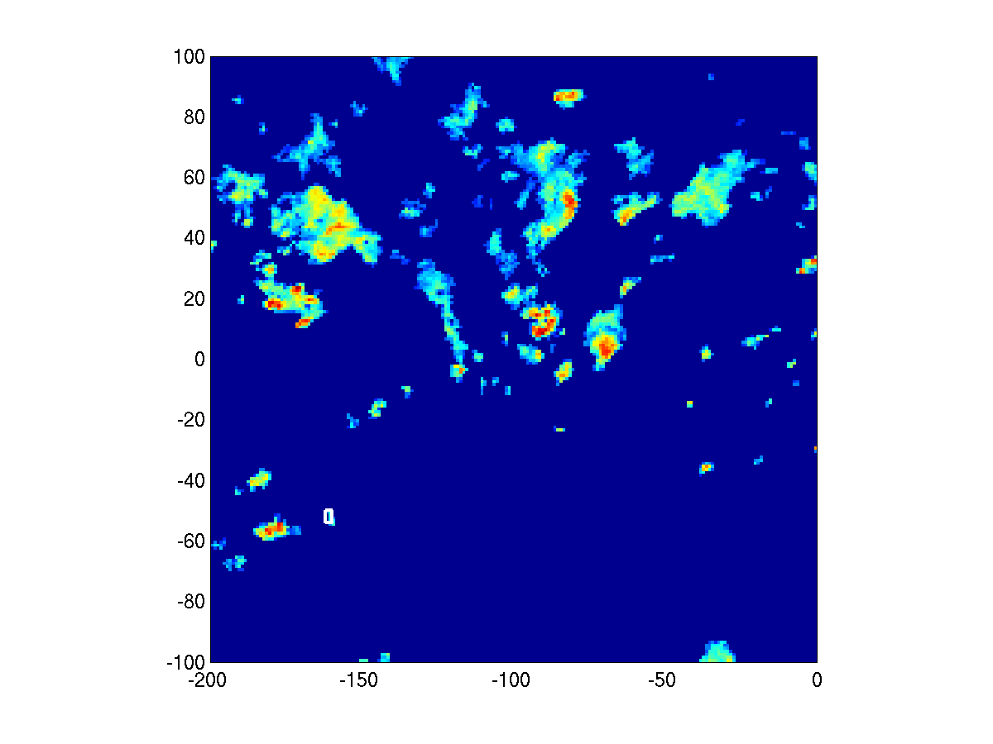
Prioritizing Storms
Scan scheduler:
  Read Nimrod scene
  Prioritize storms according to
    Distance from Chilbolton
    Size
    Intensity
    Continuity of scanning
  Issue radar commands
Allows for 3D data on storm structure to be constructed and put into context within storm lifecycle

Slide 22
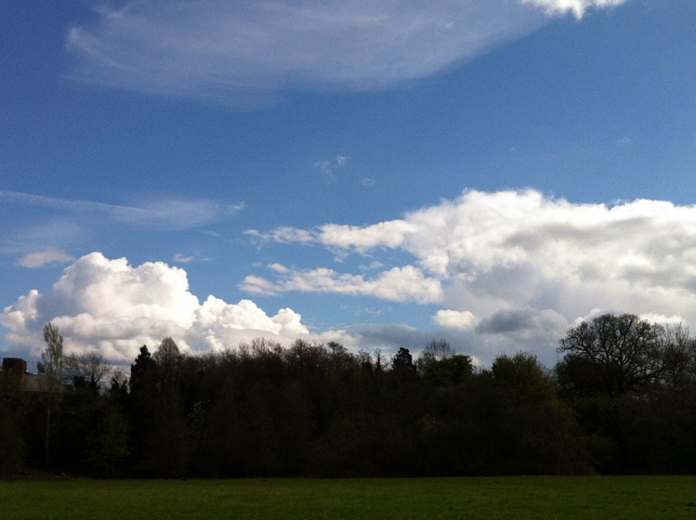

Cases scanned
41 days from 7 August 2011 to 30 August 2012
Aim was to capture a range of “typical” UK cases
Greatest concentration was for April 2012 (12 cases)
“This April is the wettest in the UK in records which date back to 1910, according to early Met Office figures to the 29th of the month.”
http://www.metoffice.gov.uk/news/releases/archive/2012/wettest-april-on-record

Slide 23
What is “realistic looking”?

Slide 24
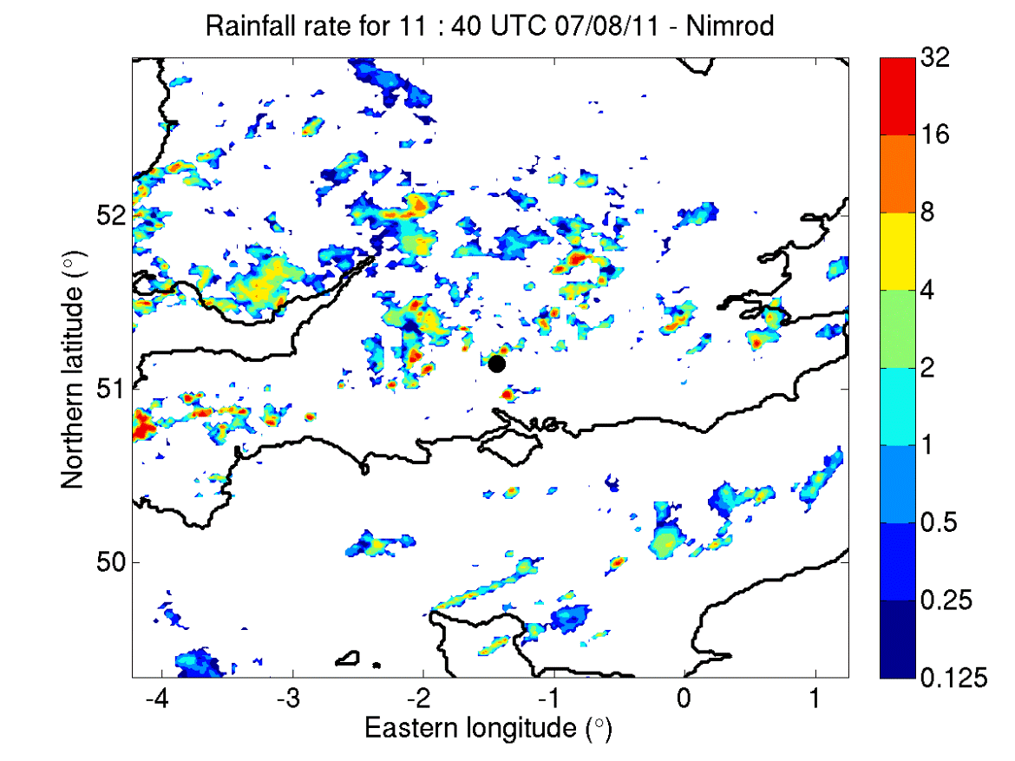
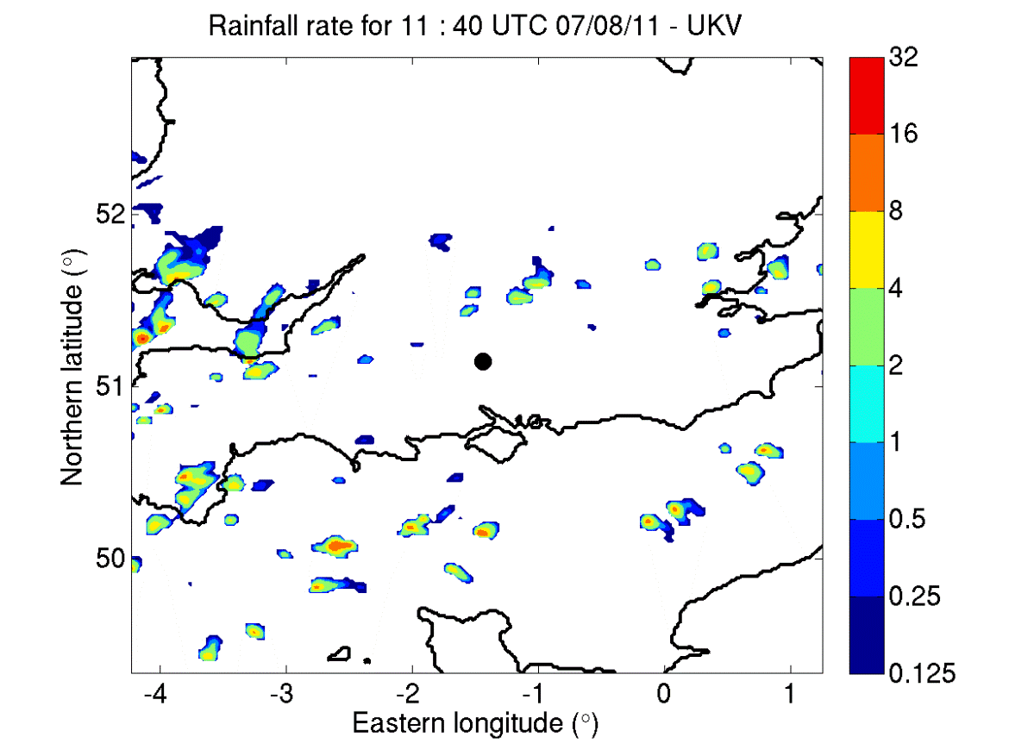
Convection-permitting models (e.g. UKV) struggle with timing and characteristics of convective storms
Example, 07/08/11
Rainfall radar (Nimrod)
1.5 km forecast model (UKV)
By eye, UKV does not have enough small storms in this case

Slide 25
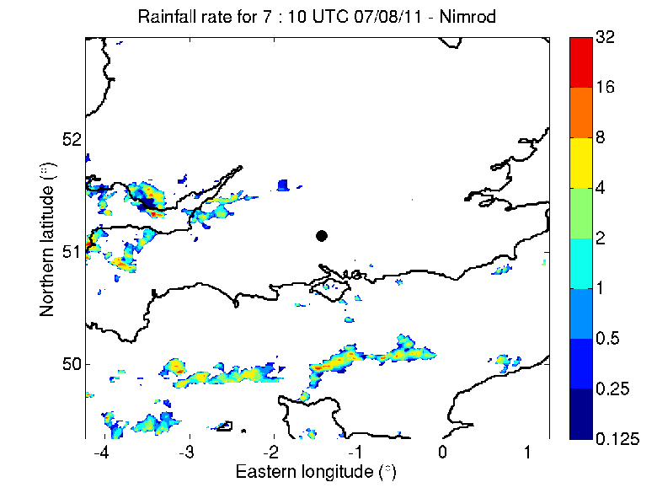
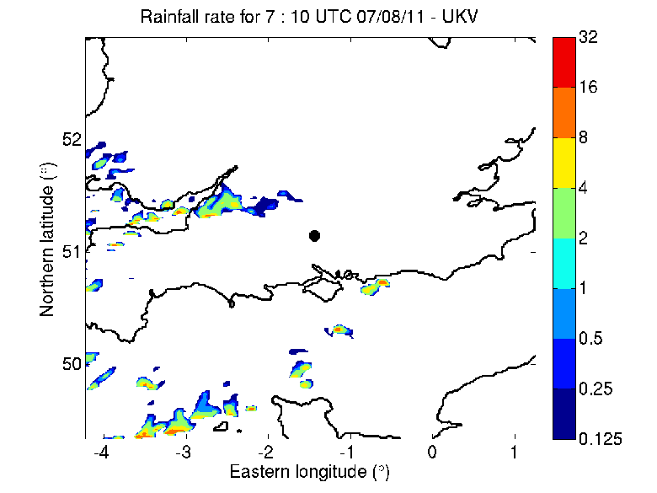
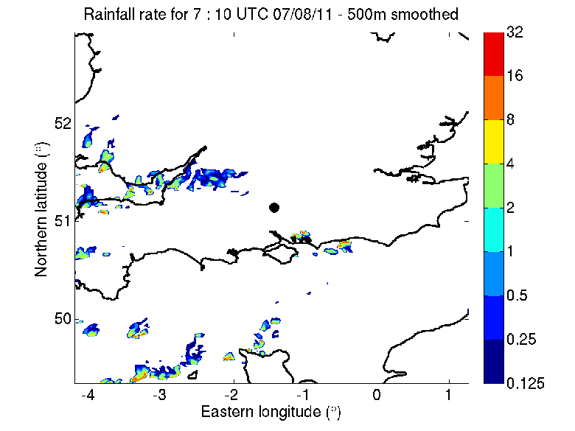
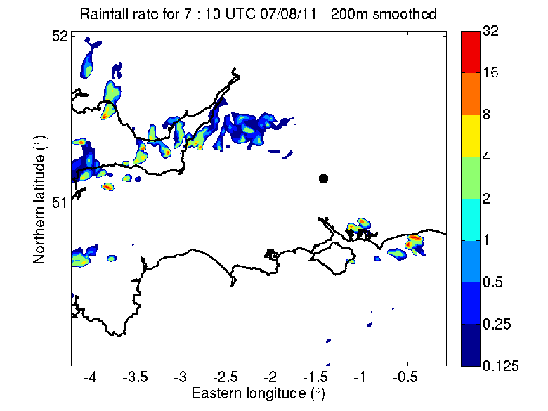
Nimrod radar
1.5-km model
500-m model
200-m model

Slide 26
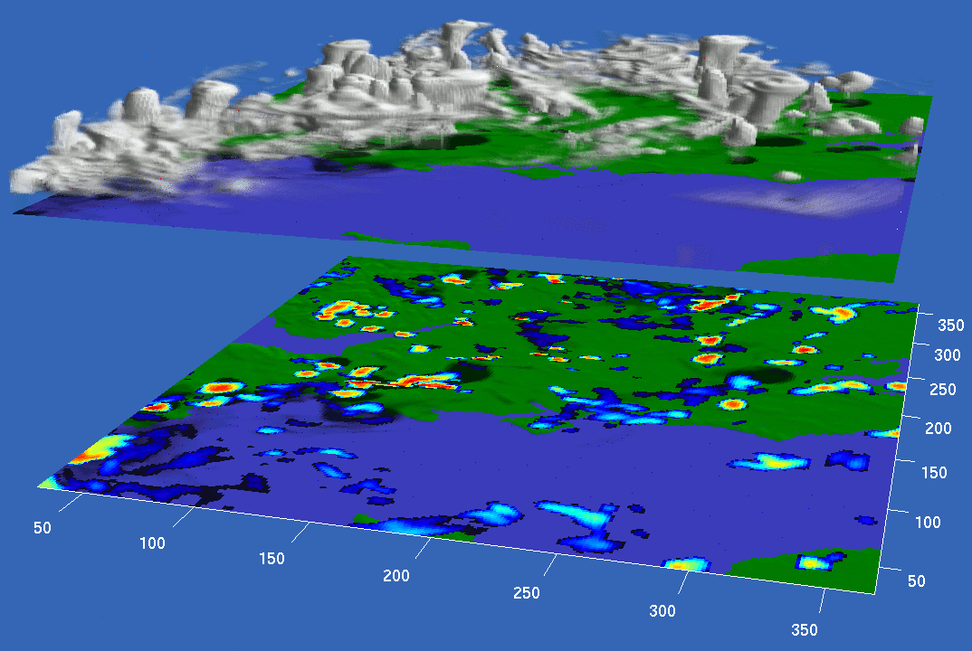
1:3.33 aspect ratio, 25/08/12

Slide 27
What is right and wrong?

Slide 28
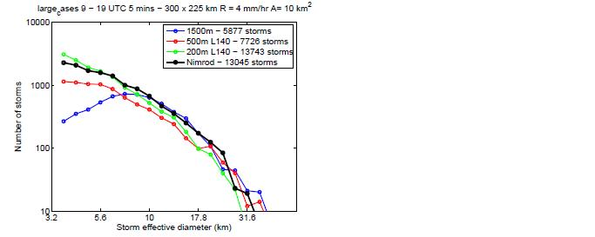
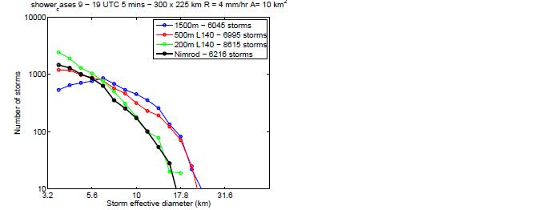
Cell sizes
Average over strong cases
Average over shower cases
500-m model best
200-m model best
200-m model best
Storms are identified using an area threshold of 10 km² and a rain rate threshold of 4 mm/hr.
Data is every 5 minutes from 09-19 UTC on the 300x225 km 200m-model domain.

Slide 29
Average cell size in the UKV
Threshold (mm/hr) | Radar effective diameter (km) | UKV effective diameter (km)
0.125 | 8.8 | 18.0
0.5 | 7.0 | 14.9
1.0 | 6.2 | 13.2
2.0 | 5.0 | 11.2
4.0 | 3.7 | 9.0
8.0 | 2.9 | 6.7
16.0 | 2.4 | 3.8
Based on ~30 cases

Slide 30
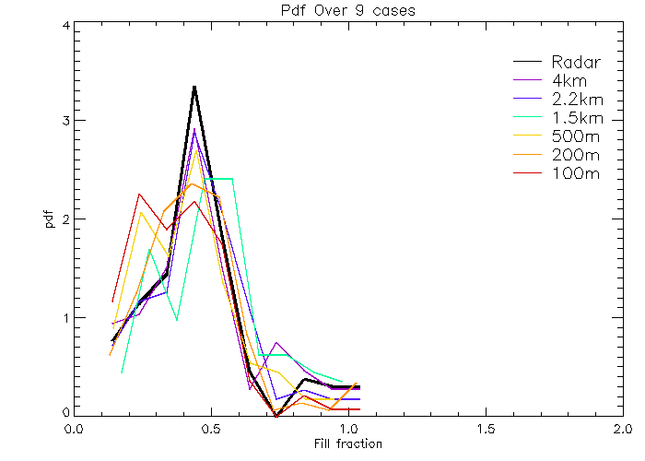
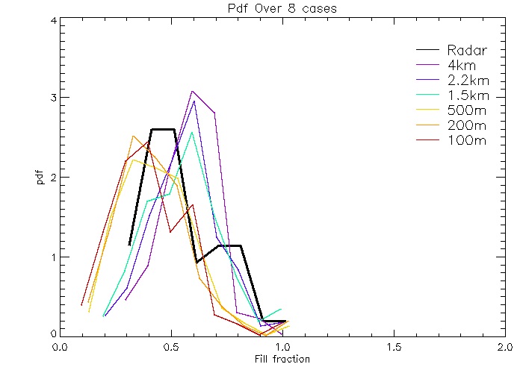
Cell shapes
Average over strong cases
Average over shower cases
Fill fraction: area of enclosing circle covered by cell, with rainfall rate > 4mm/h
Larger grid lengths give rounder cells, smaller grid lengths more elongated

Slide 31
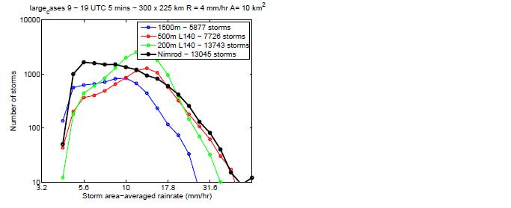
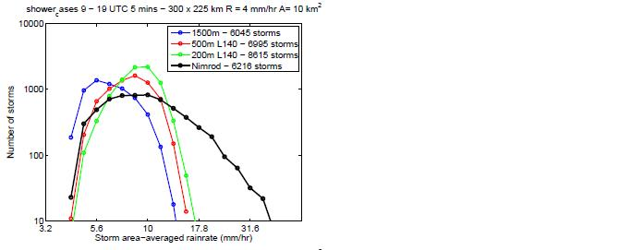
Rain rate distributions
Average over strong cases
Average over shower cases
Model struggles to get largest rain rates, except for strong cases at higher resolutions
Models are not variable enough

Slide 32

Mixing length effects
The UKV has a boundary-layer parameterization based on semi-empirical vertical mixing profiles in a range of boundary layer types, with horizontal mixing based on Smagorinsky-Lilly
The 500m and 200m use the full 3D Smagorinsky-Lilly scheme
The subgrid eddy-viscosity,
Here
l is a mixing length, Δ is the horizontal gridlength, and c_{s} is a constant, normally taken as 0.2 in LES.
Here we vary l such that it is equivalent between the different resolution models

Slide 33
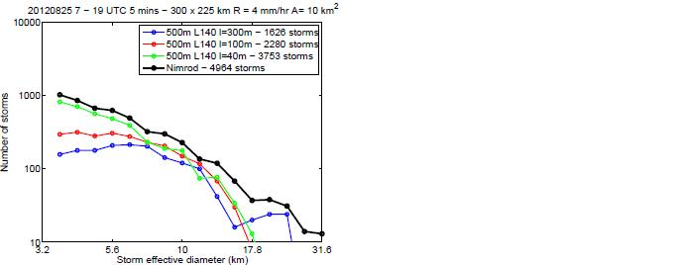
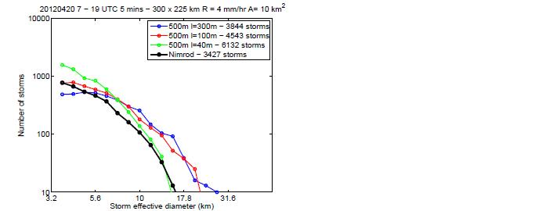
Mixing length effects, 500m model
Example strong case, 25/08/12
Example shower case
500m-model run with a mixing length of 300m, 100m (standard) and 40m.
The mixing length plays a key role in determining the number of small storms.

Slide 34
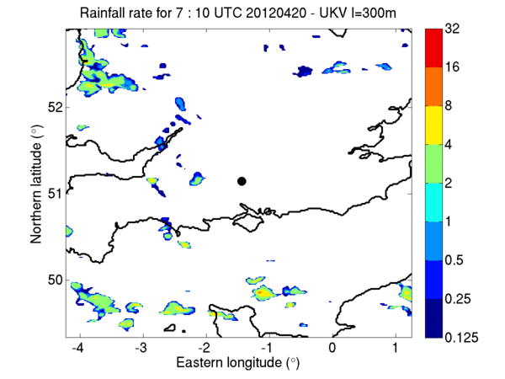
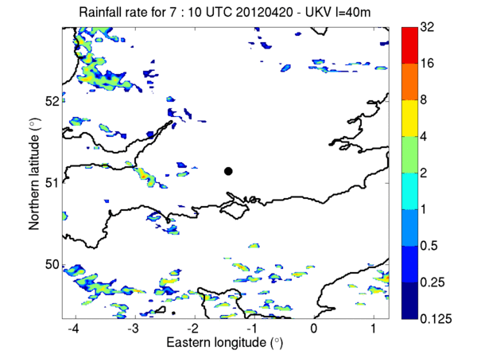
Varying the mixing length, UKV
Example shower case, 20/04/12
UKV with l=300m
UKV with l=40m
Decreasing l, decreases the subgrid mixing, decreasing the smoothing of fields and can increase the number of small cells.

Slide 35
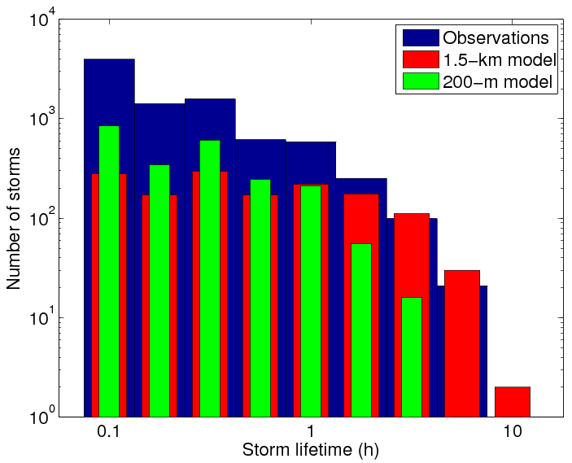
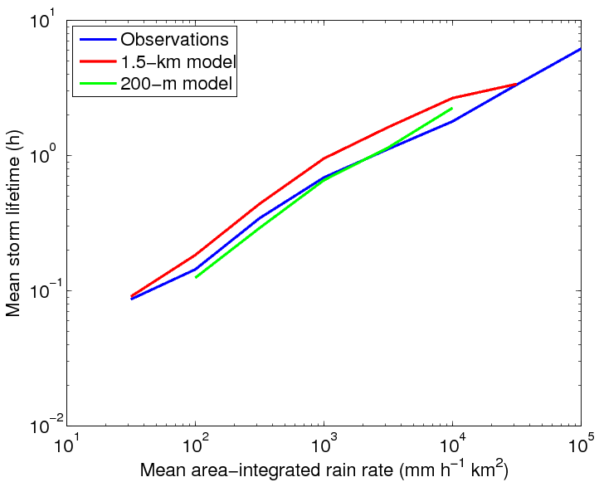
Lifetimes
UKV tends to overpredict storm lifetime by 30%
200m model agrees better with observations

Slide 36
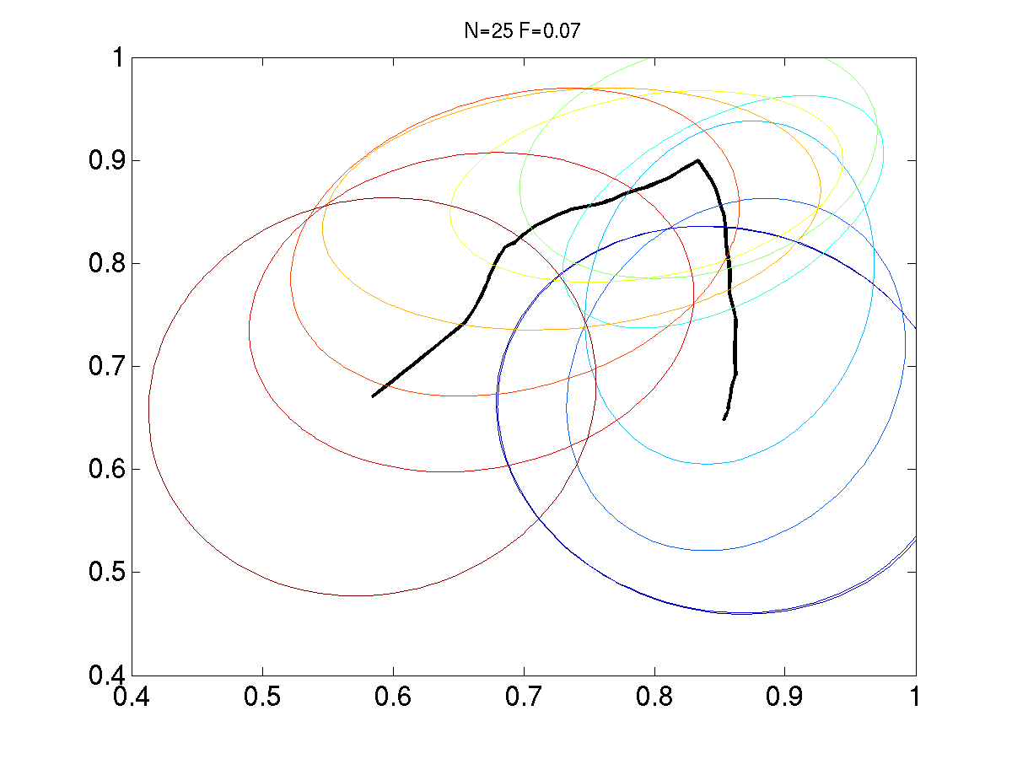
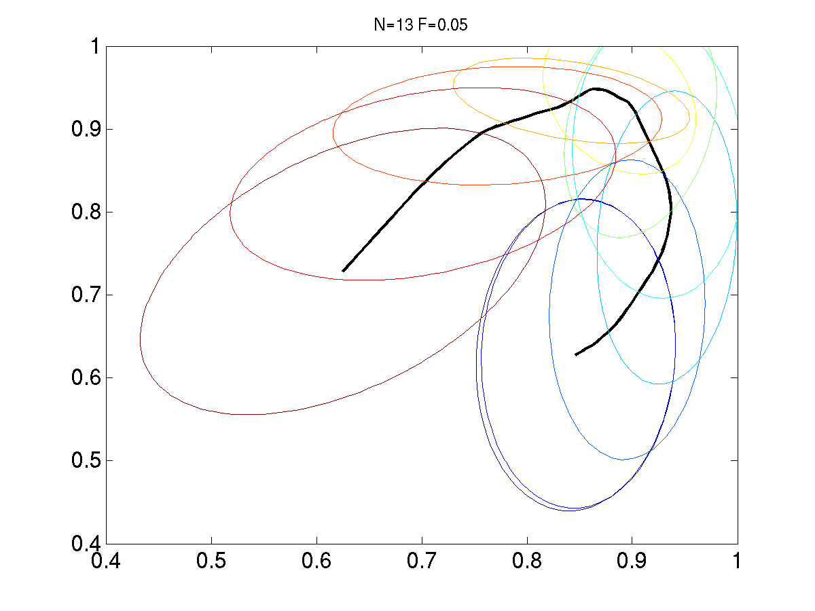
Combine area and rainfall for life cycle
Observations
Model (UKV)
Normalised area
Normalised mean rainfall
Composite storm life cycle with ellipses indicating standard deviation
Model storms are too self-similar
Spend too long at their peak area

Slide 37
Internal structure
Compare vertical structure using 3D radar data and with model data converted into reflectivity
Size of storms as measured with10dBZ contour (cloud), 20dBZ (rain) and 40dBZ (heavy, convective rain)
Storms ordered based on the height and shown from relatively shallow (top of page, 1st-6th decile) to relatively deep (bottom of page, 10th decile)

Slide 38
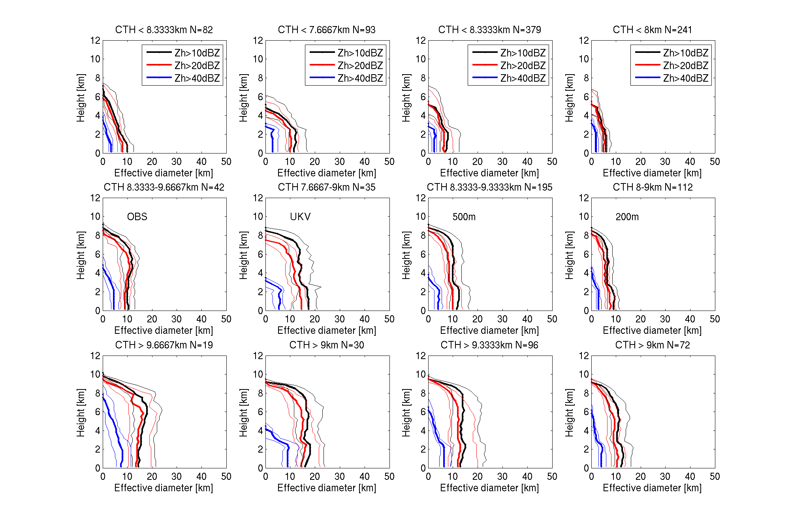

Slide 39
Example strong case, 25/08/12
Model clouds too large in UKV at 10 and 20 dBZ
Increasing resolution to 500m improves things
Clouds become clearly too small at 200m
Model struggles to get the high reflectivity core
New treatment of graupel seems to improve on this, although possibly the cores then become too wide

Slide 40
Conclusions
Current NWP is run at resolutions for which the dynamics produces convective clouds, but not with many grid points
UKV storms tend to be too much alike (not enough variability) and too persistent
UKV does not produce enough small storms (smaller than 40 km²)
More small storms at 500 and 200m (200m better on days with many small storms but too many on other days)
Can exert some control over small storms with mixing length changes

