Slide 1
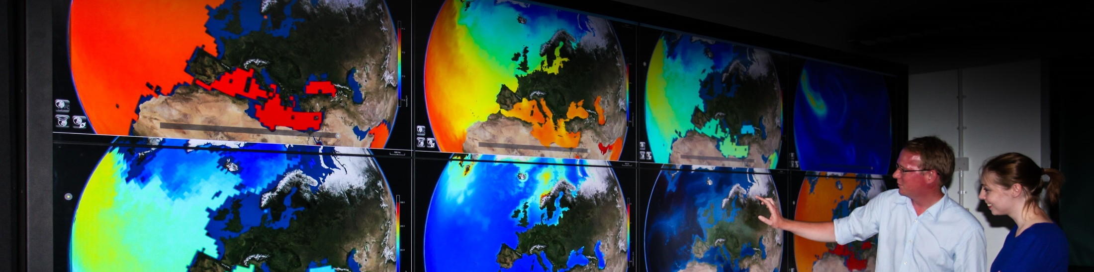
Careers in meteorology and environmental physics
Department of Meteorology
Forecast for the future

Slide 2
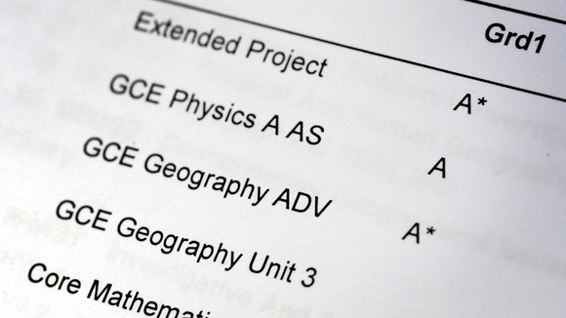
Pathway to Careers in Meteorology and
Environmental Physics
Step 1
ABB - 3 good A levels, including
A or B Physics and Maths

Slide 3

Pathway to Careers in Meteorology and
Environmental Physics
Step 2
A degree in one of the following
subjects:
      BSc Meteorology & Climate
      BSc Environmental Physics
      MMet – with a year in Oklahoma!
      Mmaths – Maths and Meteorology
  BSc Physics
  BSc Mathematics

Slide 4
Pathway to Careers in Meteorology and
Environmental Physics
Post graduate level:
MSc courses in Meteorology
      Atmosphere, Ocean & Climate
      Applied Meteorology
      Data Assimilation and Inverse Methods in Geosciences
      Applied Meteorology and Climate + Management

Slide 5
Careers
Forecasting
With organisations around the word including the UK Met Office and a range of private forecasting companies.
Research in Weather, Climate and Environmental Science
At universities and government research centres around the world.
Consultancy
For industries in the UK and overseas whose business is affected by weather, climate factors and other environmental factors
Notes:
The UK Met Office with its HQ in Exeter is the major recruiter of forecasters, followed by commercial companies that hire
a few forecasters every year. These include Meteogroup (central London) and FUGRO (Wallingford) that both have offices overseas too.
Research careers are offered by larger weather services and universities in many countries.
Working as a weather expert/consultant in industry is growing, with great interest from insurance and energy trading concerns for example.

Slide 6


Spotting a theme?
International Opportunities
Governments and Industry Partnerships
Global Scale
Cooperation
World Meteorological Organisation
Notes:
Meteorology is a career with international opportunities.
Governments and industries around the world need to factor weather and climate trends into their forward planning. As the atmosphere knows no national boundaries, international cooperation at a global scale is essential. The WMO based in Geneva is an agency of the United Nations which provides the framework for this international cooperation.

Slide 7
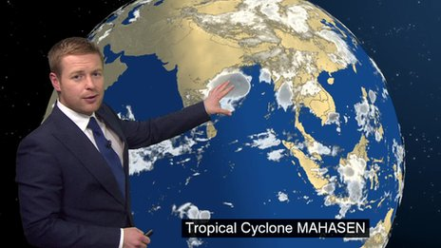
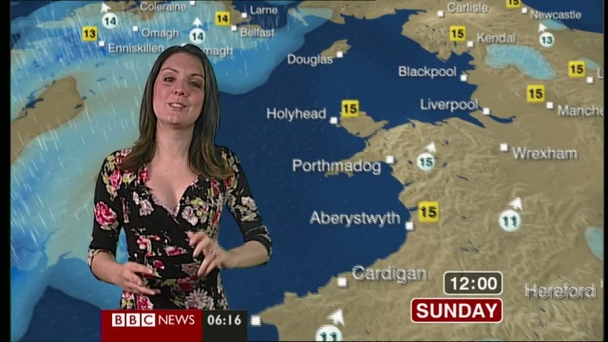
Forecasting
Met Office is the main employer of forecasters
Other organisations in the UK and abroad that employ forecasters
BBC, ITV employ national & regional forecasters and programme researchers
Tomasz Schafernaker
Laura Tobin
Notes:
The UK Met Office recruits not only weather forecasters who typically work at HQ in Exeter or at a Royal Air Force base, but also
research scientists. Researchers are based in Exeter but collaborate strongly with a few preferred Universities in the UK- Reading’s Meteorology Department is one such link, housing the Metoffice@Reading centre.

Slide 8
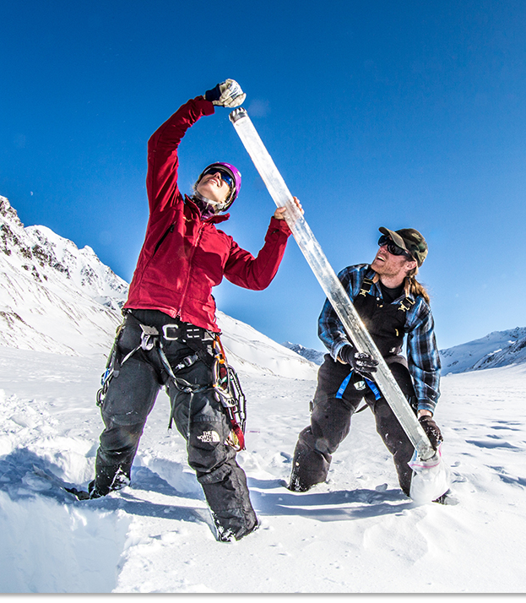
Research and Academia
Department of Meteorology at Reading is one of the leading centres for weather, space weather and climate.
New multimillion funded Institute for Environmental Analytics hosted at Reading
Researchers are part of international teams.
(Un)usual places:
  Active volcanoes- sample dust
  Arctic - sea ice formation and
  destruction
  Deserts - dust storms
  Storm clouds - fly research aircrafts
  Tropics - cyclones and typhoons
Notes:
Reading’s Department is recognised widely as world-leading. It has a wide range of research groups involving scientific staff from many nations.

Slide 9

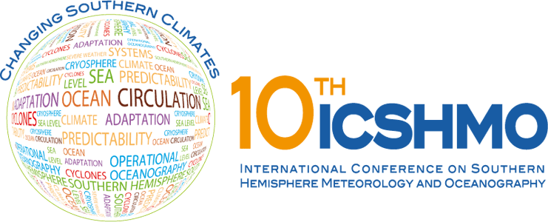

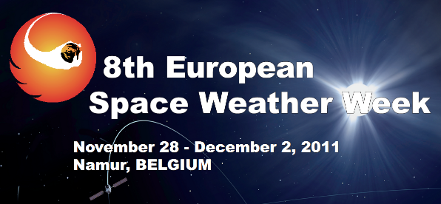
Not to mention....
Conferences worldwide
Notes:
Regular conferences and workshops, covering all areas of weather and climate research take place annually, sponsored by
the WMO and other Meteorological Organisations, both in the UK and abroad. These are attended by people working in all areas of meteorology
and climate science.

Slide 10
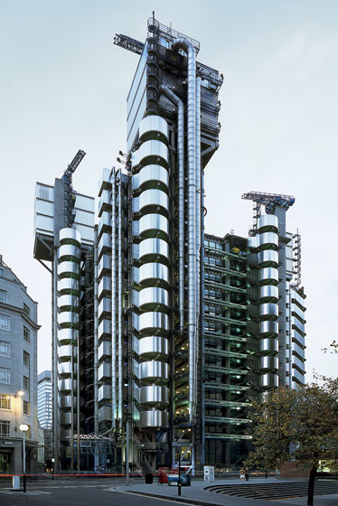

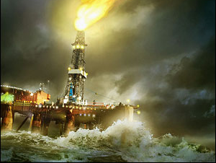
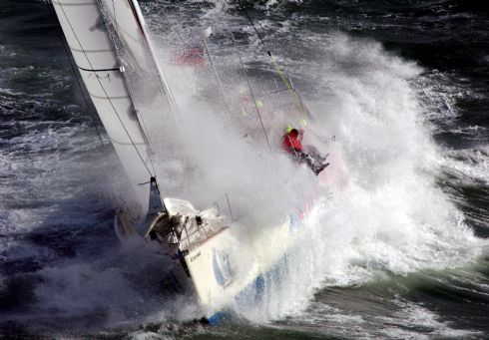

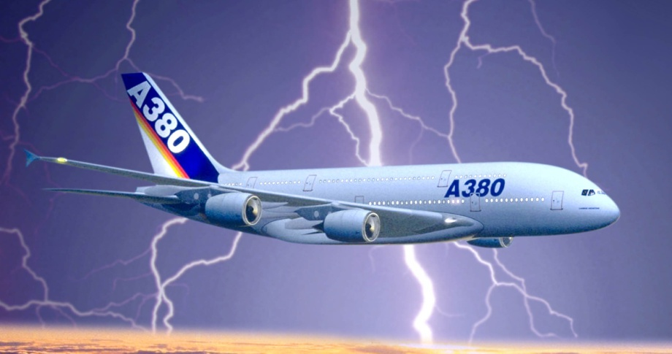
consultancy
Aviation – RAF and civil
Shipping – RN and commercial vessels
Energy providers/traders
Investment Bankers
Insurance companies and re-insurers
Government:
  Health protection (heat waves and cold snaps)
  Highways Agency/Local Authorities (gritting)
  Environment Agency
  Flood defence/prediction (Rivers & coastal
Agriculture – crop spraying, harvesting
The Emergency Services
Leisure organisations – sports events
Notes:
The need to be able to predict the weather and plan accordingly affects many users. These include
Transport
Aviation - optimising routes (e.g. to minimise turbulence)
Shipping - Round the World sailing teams employ Meteorologists to fly ahead from port to port and forecast local conditions, prevailing winds etc.
including ship routeing, planning oilrig tows
Energy providers including energy trading, - peaks in demand
Renewable Energy firms (env phys)
Weather derivatives – shares which act as a hedge fund to allow organisations eg. farmers, theme parks, to insure against adverse weather.
Insurance – re-insurers, weather, + env phys - risks to satellites and power grids from space weather

Slide 11
Actual Careers
TV Forcasters:
  Laura Tobin ITV Good Morning
  Tomas Schafernacker BBC Main News
  Jay Wynne BBC Main News
  Holly Green BBC South
  Sean Batty ITV Scotland
  Simon King Radio 5 Live

Slide 12
More Careers
Meteorologist for Swedish Olympic Sailing Team
Senior Scientist, National Centre for Atmospheric Research, Boulder Colorado
Manager New Zealand Weather Service
Weather Producer Sky TV
Data Manager, British Antarctic Survey
Head of Forecast Office, Heathrow
Senior Analyst, Vattenfall Wind Energy, London
Meteorologist EDF Trading, London
Meteorologist Officer, Royal Navy
Head of Catastrophe Research, Hiscox Insurance, London
Chief Meteorologist, Northern Territory, Darwin, Australia

Slide 13

Employment Rates
85%
Is the employment rate for people with a degree in Meteorology. This is extremely high, with around 85% of graduates finding employment in a related career.

